Slide 1

Personal Finance Presentation PowerPoint
PowerPoint Presentation Sample
*This is a sample of the NFEC’s Personal Finance Presentation PowerPoints. You can access the full presentation at https://www.financialeducatorscouncil.org/financial-literacy-curriculum/

Slide 2

Loans & Debt, Types Of Debt
Personal Finance Presentation PowerPoint

Slide 3
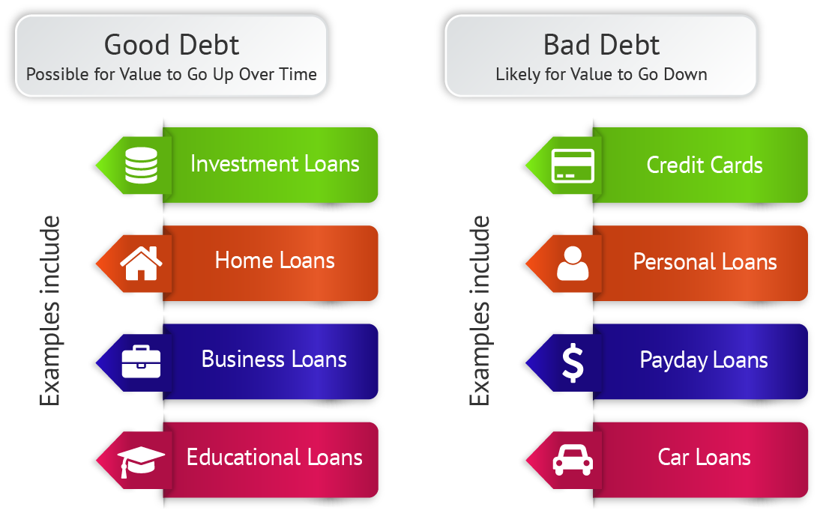
Good Debt Vs. Bad Debt
Loans & Debt, Types of Debt - Personal Finance Presentation PowerPoint

Slide 4

Good Debt
Loans used to purchase items that appreciate in value
Loans used to create revenue streams
Loans used to buy assets
Typical examples:
  Home mortgages
  Investment loans for high ROI
  Business loans
  Educational loans
Loans & Debt, Types of Debt - Personal Finance Presentation PowerPoint

Slide 5

Bad Debt
Loans used to purchase items that depreciate in value
Loans used to purchase items that don’t improve one’s financial situation
Typical examples:
  Credit cards
  Personal loans
  Payday loans
  Car loans
Loans & Debt, Types of Debt - Personal Finance Presentation PowerPoint

Slide 6

Grey Areas: Good Debt Can Become Bad Debt
Mortgage on a property that loses value
Student loan when you drop out of school
Student loan when your earning potential is not what you expected
Investment loans for a stock that tanks
Loans & Debt, Types of Debt - Personal Finance Presentation PowerPoint

Slide 7

Grey Areas: Bad Debt Can Become Good Debt
Using a credit card to buy clothes that help you land a great job
Using a credit card to buy something that appreciates in value
When you pay your credit card balance in full every month
When you get a car loan for the minimum vehicle you need to earn income
Loans & Debt, Types of Debt - Personal Finance Presentation PowerPoint

Slide 8

Loans & Debt, Loan Fundamentals
Personal Finance Presentation PowerPoint
Notes:
https://www.dropbox.com/sh/divlqzpn4e6tumz/AACtEsXsYadEn9-YXreAeC0Fa/Grab%20Batch%20Pics%2010%20Chapter%202/iStock-1045381132.jpg?dl=0

Slide 9
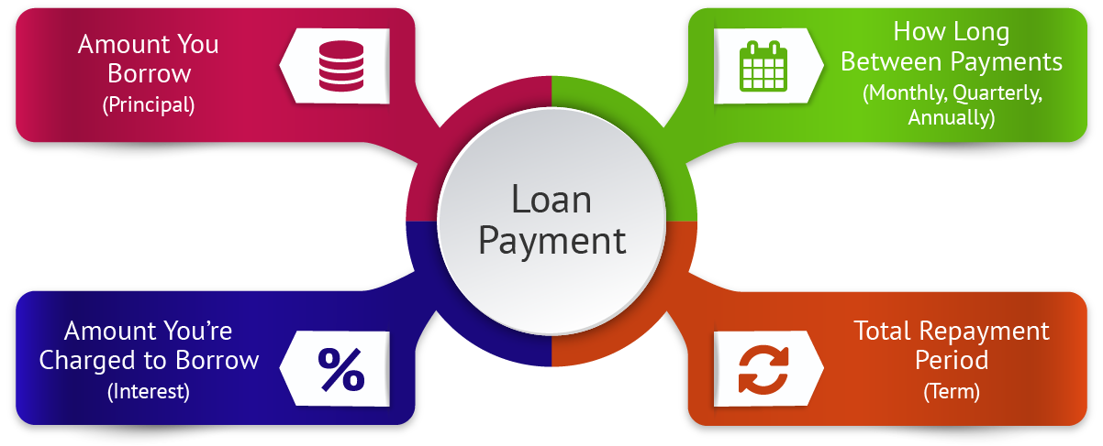
Components Of A Loan Payment
Loans & Debt, Loan Fundamentals - Personal Finance Presentation PowerPoint

Slide 10

Fundamentals Of A Loan
Principal balance
  The total amount you owe
Interest
  Amount the lender charges you to borrow the money
Interest rate
  Percentage at which interest is calculated
    Determined by the level of risk the lender thinks you pose
Payment interval
  How often you must make payments
Term
  Amount of time you have to repay the loan
Loans & Debt, Loan Fundamentals - Personal Finance Presentation PowerPoint

Slide 11
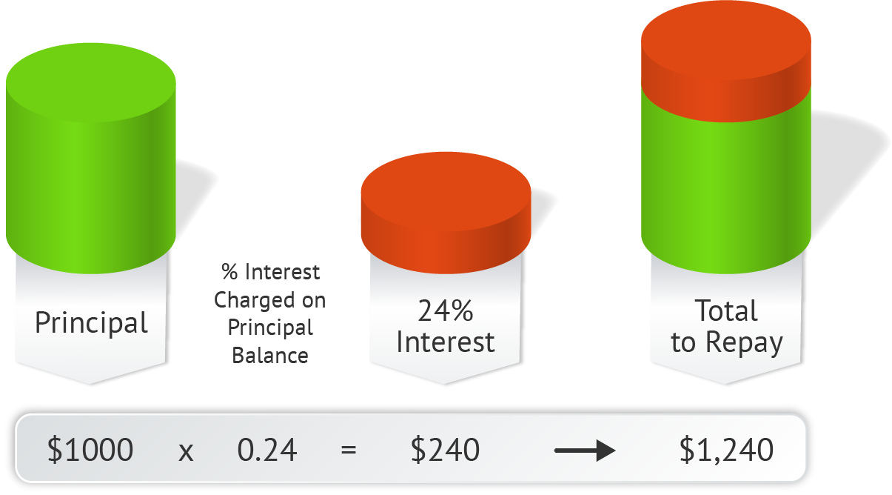
Simple Example
Loans & Debt, Loan Fundamentals - Personal Finance Presentation PowerPoint

Slide 12

Compounding Interest
Essentially, “interest paid on interest”
When a debt compounds, any unpaid interest is added to the principal
Then you pay interest not only on the principal, but on the unpaid interest too

Slide 13
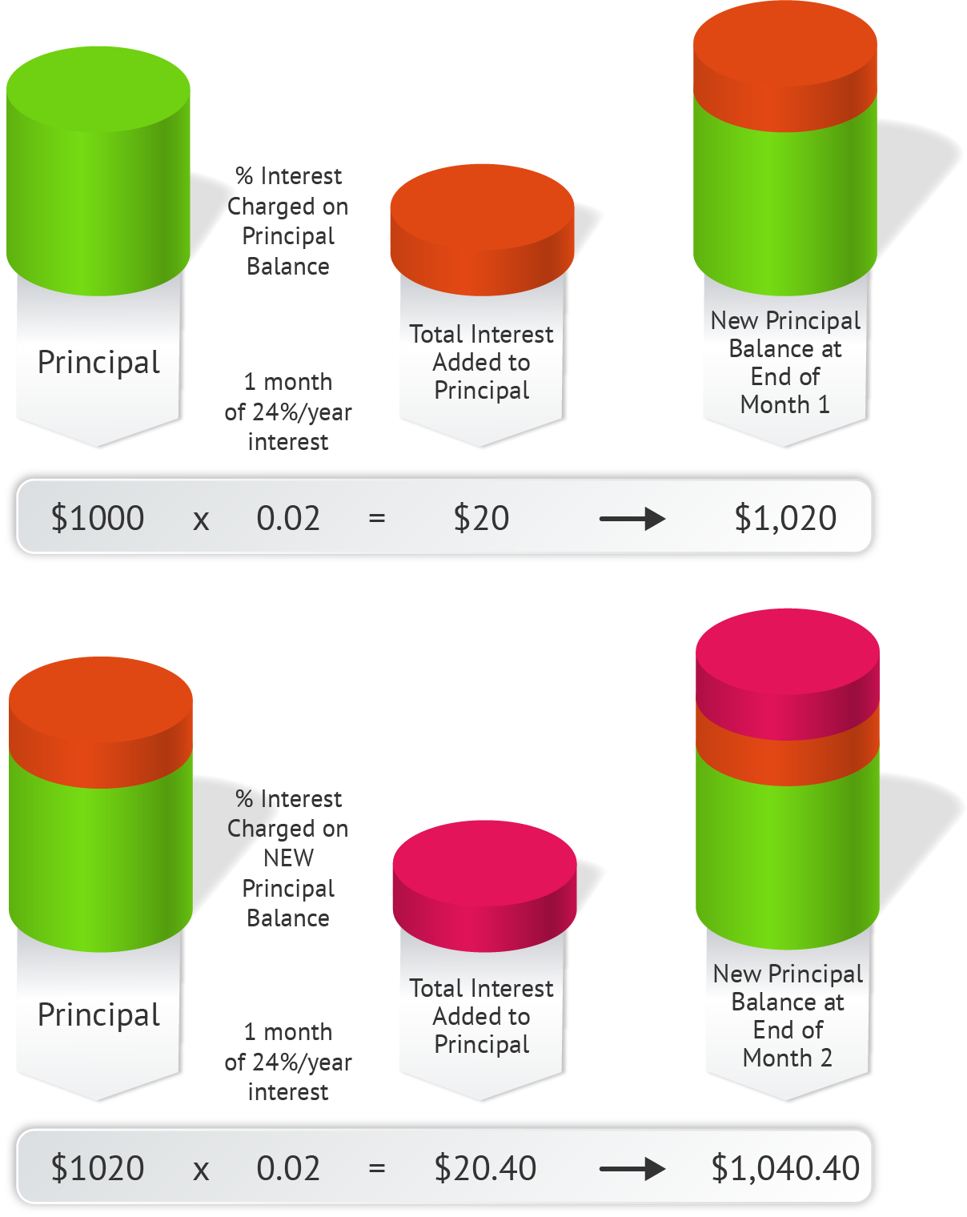
Compounding Interest Example
Loans & Debt, Loan Fundamentals - Personal Finance Presentation PowerPoint

Slide 14

Amortization Introduction
Every payment contains a principal payment and an interest payment
The proportion that goes to interest is higher early in the loan term
That procedure is called amortization
So making extra payments above your fixed payment reduces the principal faster early in the loan term
Loans & Debt, Loan Fundamentals - Personal Finance Presentation PowerPoint

