Slide 1

Money Management PowerPoint Presentations
PowerPoint Presentation Sample
*This is a sample of the NFEC’s Money Management PowerPoints Presentation. You can access the full presentation at https://www.financialeducatorscouncil.org/financial-literacy-curriculum/

Slide 2

Budgeting, Budgeting Fundamentals & Overview
Money Management PowerPoint Presentations

Slide 3

Benefits of Budgeting
Gives you control over your money
Keeps you focused toward your financial goals
Helps you stay aware of where your money goes
Helps you save for expected and unexpected costs
Clarifies areas where you can save money
Budgeting, Budgeting Fundamentals & Overview - Money Management PowerPoint Presentations

Slide 4
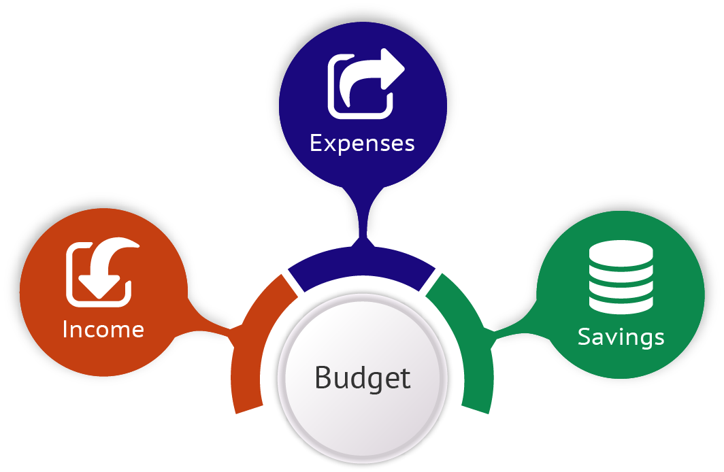
Definition of a Budget
“A finance plan that allocates future personal income toward expenses, savings, and debt repayment.”
Budgeting, Budgeting Fundamentals & Overview - Money Management PowerPoint Presentations

Slide 5



Three Main Components of a Budget
Income
Money you earn from a range of sources.
Expenses
Outgoing funds you pay to others
Savings
Anything you have left over after paying your expenses.
Budgeting
Budgeting, Budgeting Fundamentals & Overview - Money Management PowerPoint Presentations

Slide 6
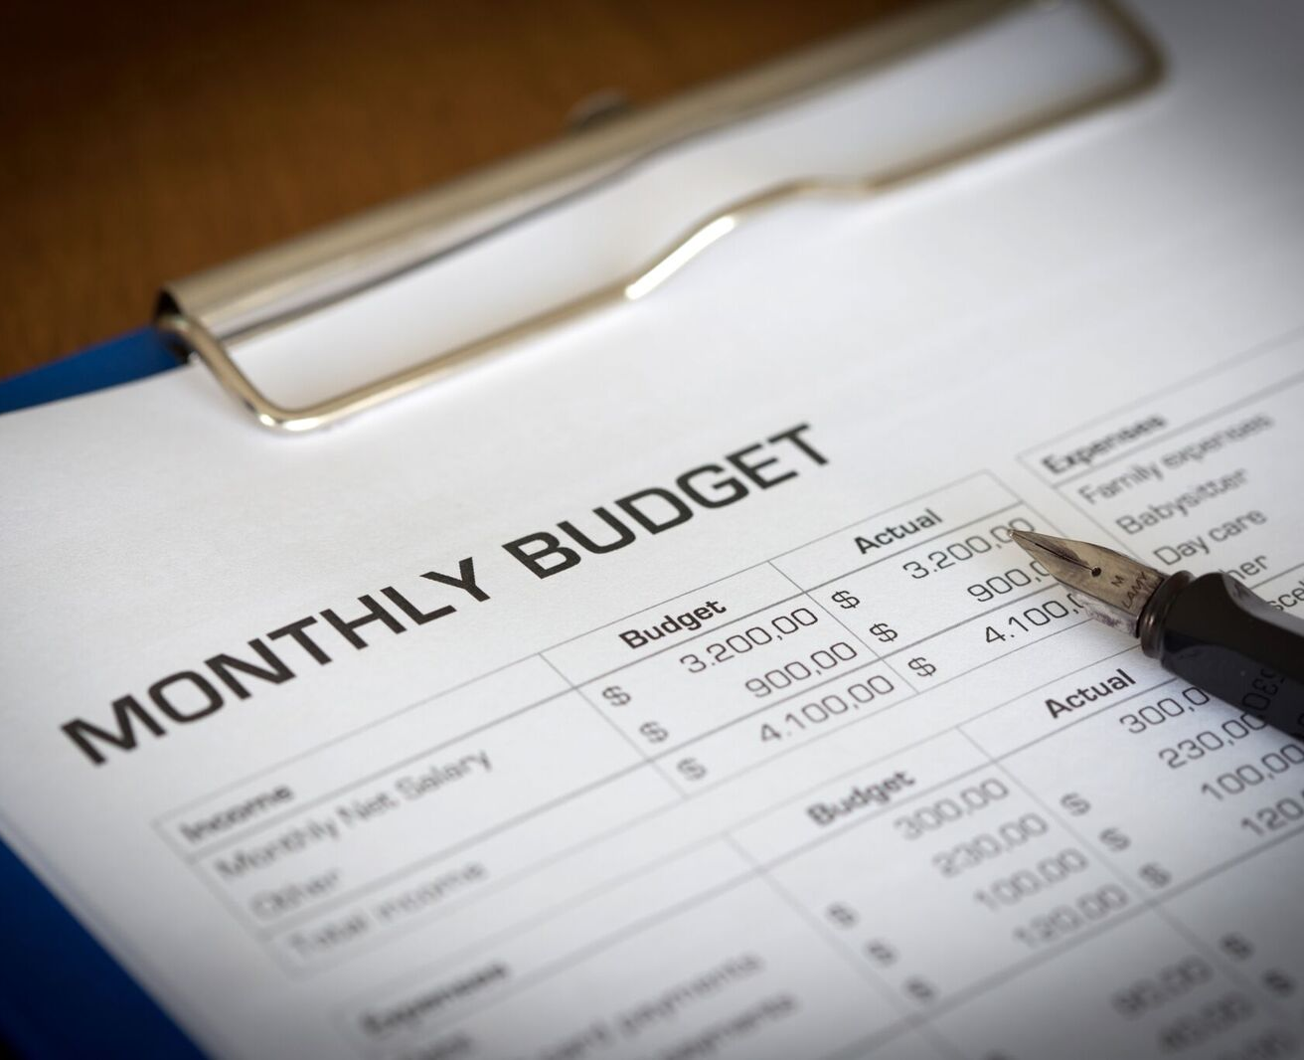
Where to Start when Developing a Budget
Understand your money and how you spend it
Make tough decisions about spending priorities
Budget with a lifestyle in mind
Build a budget that allows you to save
Budgeting, Budgeting Fundamentals & Overview - Money Management PowerPoint Presentations

Slide 7

Budgeting With A Lifestyle In Mind
Clarify the life aspects you give priority, and then split them into 3 areas:
Items that create meaning and bring you joy
Things you want, but that can wait
Things you would like to have, but aren’t essential
Budgeting, Budgeting Fundamentals & Overview - Money Management PowerPoint Presentations

Slide 8

Things to Remember about Budgeting
Make sure your list reflects your priorities
You can always adjust your goals as your priorities change
Budgeting takes time, patience, and effort
If your first attempts don’t go as planned, don’t give up
Look for ways to make tracking spending easier – like mobile apps
Budgeting, Budgeting Fundamentals & Overview - Money Management PowerPoint Presentations
Notes:
https://www.dropbox.com/sh/divlqzpn4e6tumz/AADx0mM9kK20y5D9m8J4IIf-a/Grab%20Batch%20Pics%2010%20Chapter%202/iStock-494146669.jpg?dl=0

Slide 9

What Happens if you Don’t Budget
Overspending
Falling into a debt cycle
Limited spending power
Limited savings and investments
Lack of future security
Budgeting, Budgeting Fundamentals & Overview - Money Management PowerPoint Presentations

Slide 10

Finally…
Budgeting is about saving money
Better budgeting helps you end up with more money to manage
An accurate budget brings discipline and order to your finances
Use your budget to guide important decisions
Earning more than you spend is the way to a low-stress, comfortable life!

Slide 11

Budgeting, Setting Savings Goals And Creating A Savings Plan
Money Management PowerPoint Presentations
Budgeting, Setting Savings Goals & Creating a Savings Plan - Money Management PowerPoint Presentations

Slide 12
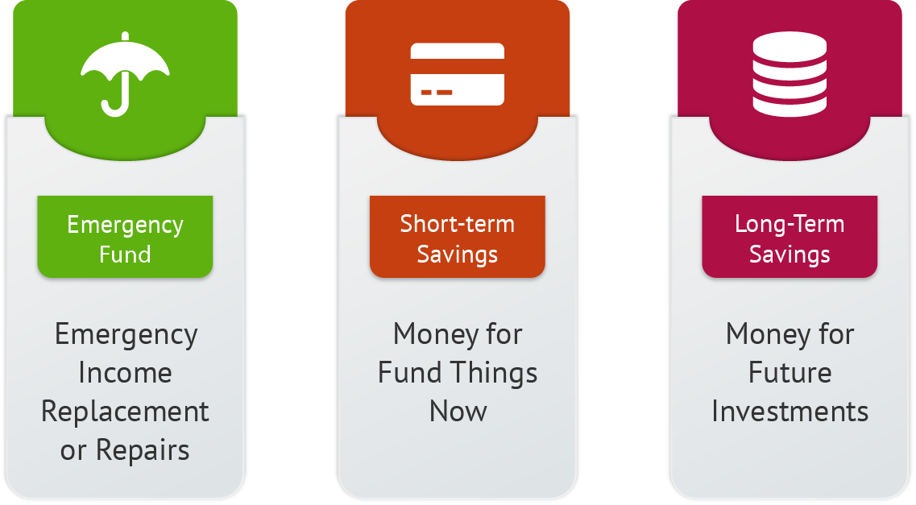
Three Components of a Savings Plan
Budgeting, Setting Savings Goals & Creating a Savings Plan - Money Management PowerPoint Presentations

Slide 13

Emergency Fund
Should be liquid (easily converted to cash)
Equal to at least 6 months of your essential living expenses
Those in downsizing or highly competitive industries should save more
Be prepared for a market collapse
Cushion for handling unexpected expenses
Budgeting, Setting Savings Goals & Creating a Savings Plan - Money Management PowerPoint Presentations

Slide 14
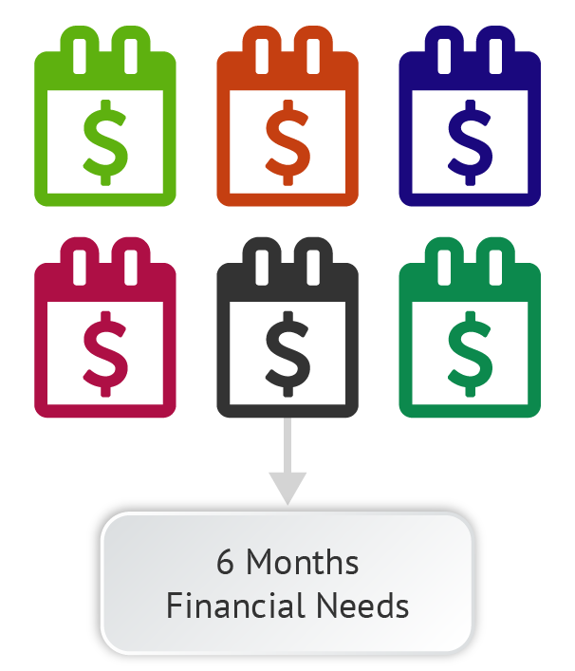
Simple Emergency Fund Calculation
  A simple calculation is to multiply your monthly financial needs by 6
Budgeting, Setting Savings Goals & Creating a Savings Plan - Money Management PowerPoint Presentations

Slide 15
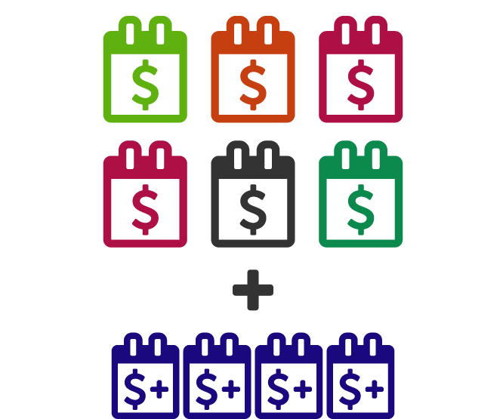
Advanced Emergency Fund Calculation
Consider the amount of tima it would take you to replace your income source if that soure were lost. Set aside at least 6 months’ worth of expenses, plus expenses for the time it would take to replace your income source.
Budgeting, Setting Savings Goals & Creating a Savings Plan - Money Management PowerPoint Presentations

Slide 16

When should you use your emergency fund?
Sudden unemployment
Replace things you must have to make money
Emergency medical expenses
Disaster recovery
Deductibles in case of accident or loss
Repairs that would result in further damage if neglected
Unexpected expenses:
  Was it impossible to plan for?
  Is it urgent?
Budgeting, Setting Savings Goals & Creating a Savings Plan - Money Management PowerPoint Presentations

Slide 17
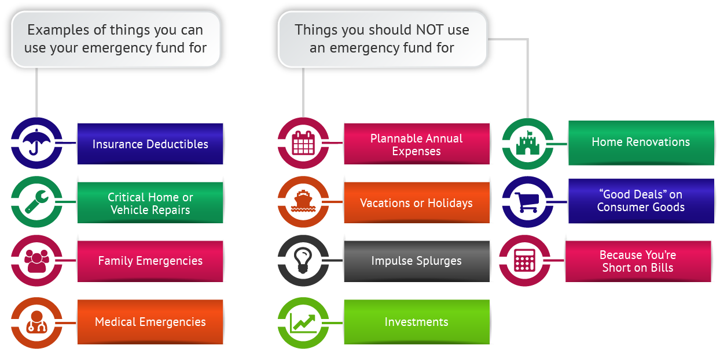
Deciding When to Use Your Emergency Fund
Budgeting, Setting Savings Goals & Creating a Savings Plan - Money Management PowerPoint Presentations

Slide 18

Short-term Savings
Money set aside for fun things now
Enjoy the fruits of your labor
Provides near-term gratification without going into debt
Gets you in the habit of evaluating and prioritizing your wants

Slide 19

Long-term Savings
Money for future investments
Long-term financial plans, such as retirement
“Pay yourself first”
Target 10% of your take-home income
Increase the amount over time
Use automatic transfers to make long-term savings routine
Budgeting, Setting Savings Goals & Creating a Savings Plan - Money Management PowerPoint Presentations

Slide 20

Setting a Long-term Savings Goal
Budgeting, Setting Savings Goals & Creating a Savings Plan - Money Management PowerPoint Presentations

Slide 21

Factors to Consider
Find out the real cost of unemployment in your industry
Caring for aging family members
Debt load vs. your savings or investment returns
Two simple ways to save more money:
  Increase income
  Cut down on expenses
Budgeting, Setting Savings Goals & Creating a Savings Plan - Money Management PowerPoint Presentations

Slide 22

Developing an Individualized Savings Plan
Set emergency fund targets
  Decide on the standard of living you’ll maintain during unemployment
Short-term savings targets
  What major expenses are coming up?
  How much do you have saved now?
  When do you need them?
Long-term savings targets
  Shoot for saving 10% of your net income
Budgeting, Setting Savings Goals & Creating a Savings Plan - Money Management PowerPoint Presentations

