Slide 1

Financial Wellness Presentation
PowerPoint Presentation Sample
*This is a sample of the NFEC’s Financial Wellness Presentations. You can access the full presentation at https://www.financialeducatorscouncil.org/financial-literacy-curriculum/

Slide 2
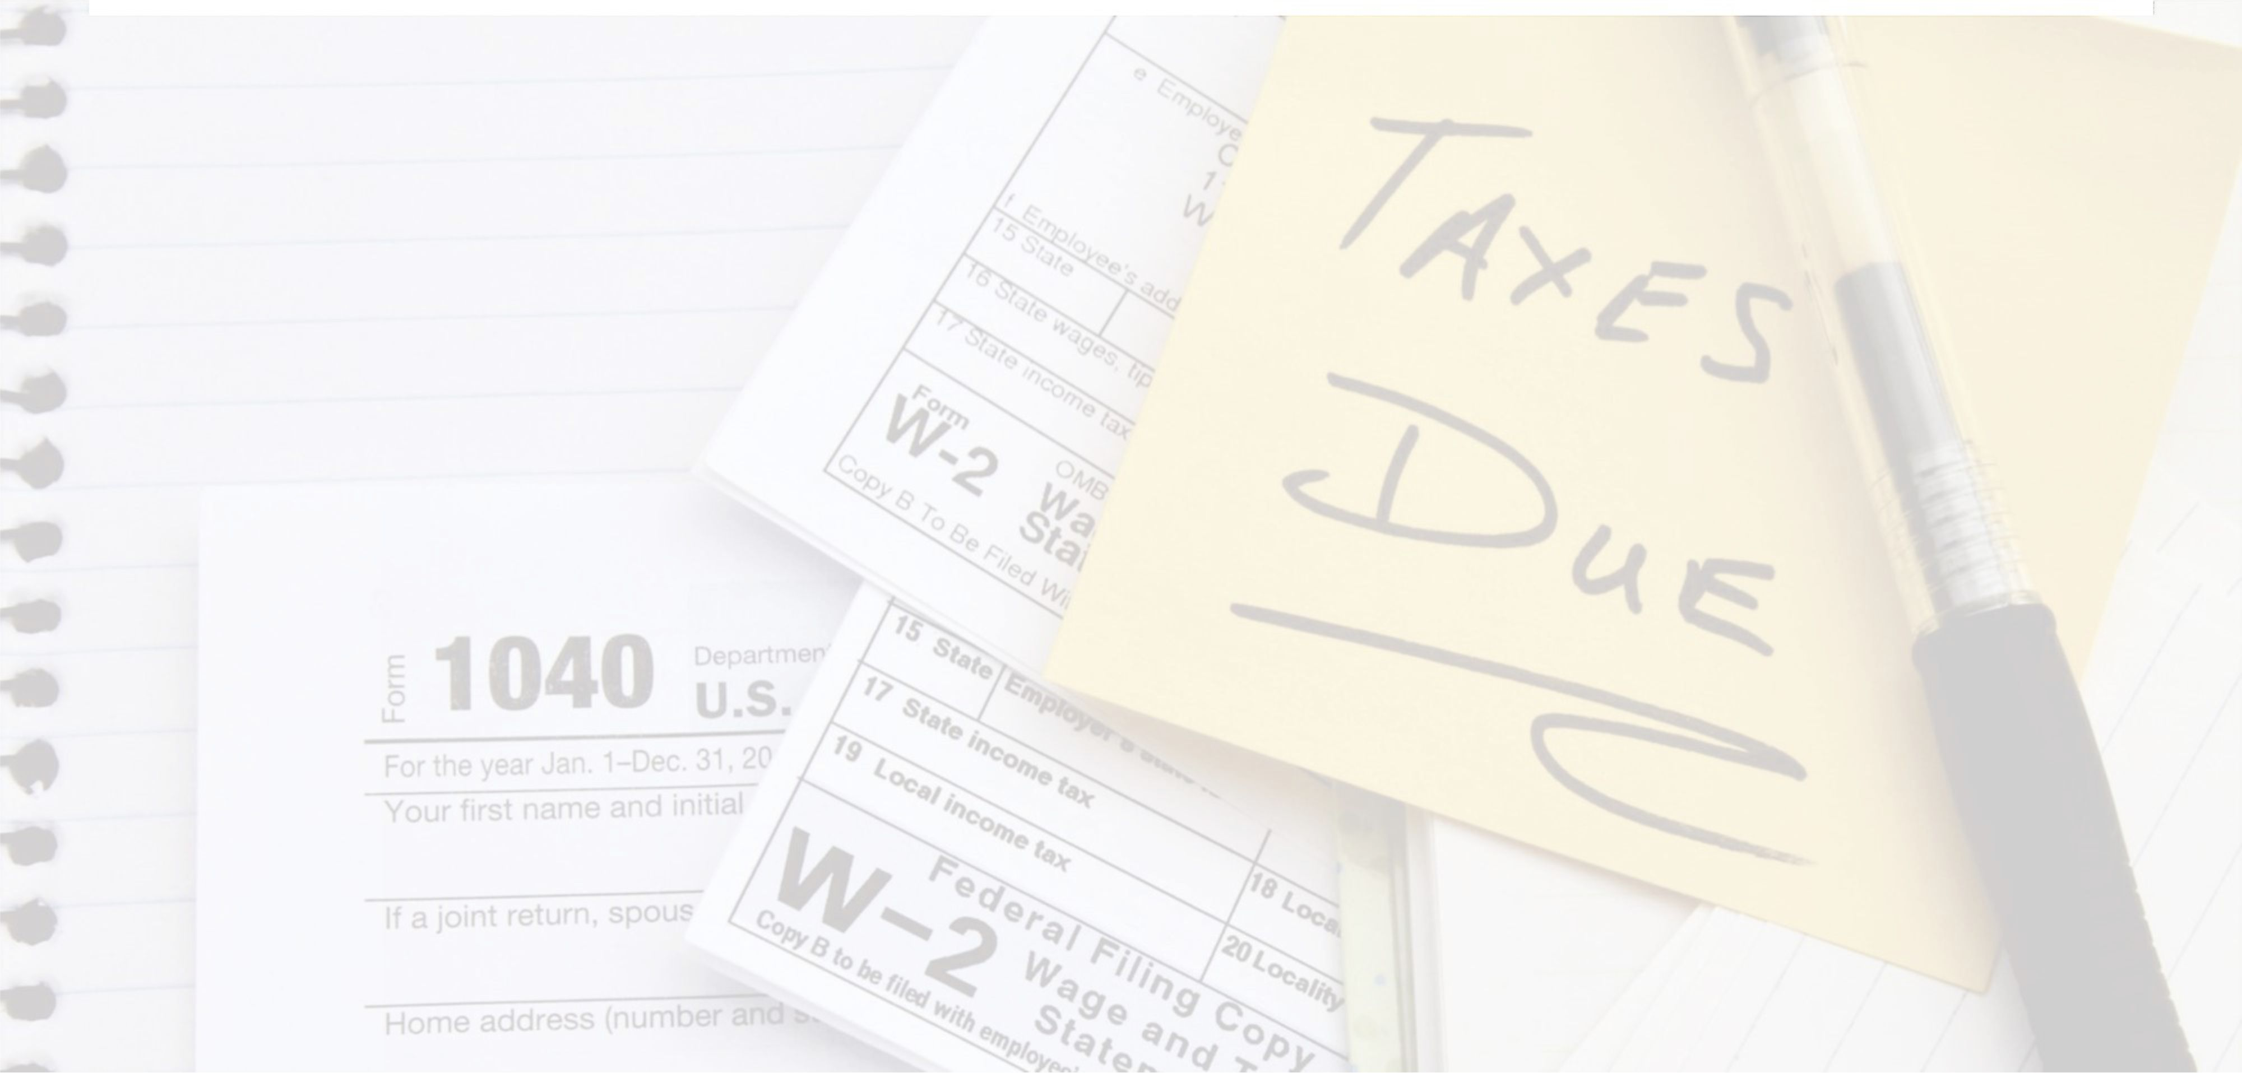
Government, Introduction to Taxes
Financial Wellness Presentation

Slide 3
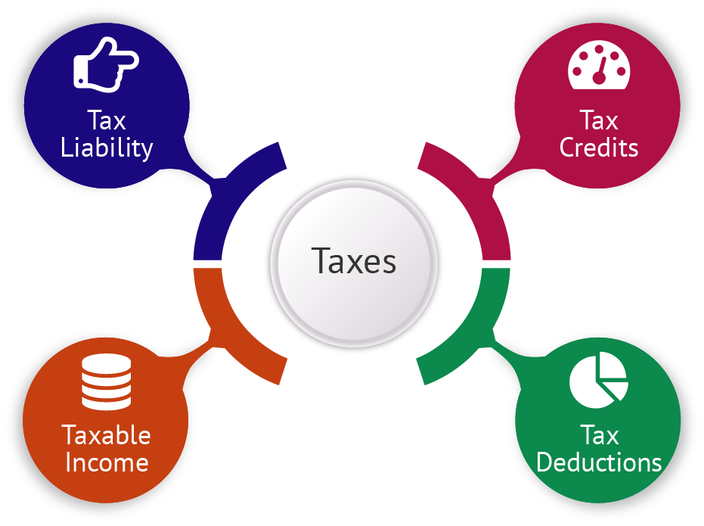
Government, Introduction to Taxes - Financial Wellness Presentation

Slide 4

Variety Of Taxes
State and federal income tax
  Mandatory contributions to government revenue, levied on income
Social Security
  System that provides benefits to the retired and disabled
Medicare
  A federal health insurance system for retirees >65 and younger people with disabilities
Investment taxes
  Taxes on investment income and capital gains
Sales tax
  Consumption taxes levied on purchase of goods and services
Excise tax
  Tax on certain things made, sold, or used within the country
Government, Introduction to Taxes - Financial Wellness Presentation

Slide 5

Federal Income Tax
Tax returns must be filed annually with the IRS by April 15
Severe penalties for filing incorrect returns
Large or suspicious errors will result in an audit
In an audit, you must prove your calculations with receipts and bank statements
The burden of proof is on you – the taxpayer
Working with a trusted tax professional is recommended
Government, Introduction to Taxes - Financial Wellness Presentation

Slide 6

Legal Ways To Reduce Tax Liability
Tax deductions
  Standard deduction
  Itemized deductions
  Reduce your taxable income
Tax credits
  Subtracted directly from the tax you owe
  Various tax credits available
  May differ year-to-year
Government, Introduction to Taxes - Financial Wellness Presentation

Slide 7

Tax Definitions
Tax liability
  Total amount of tax debt owed
Taxable income
  Amount of income used to calculate tax owed
Standard deduction
  Set dollar amount that may be subtracted from income on a tax return
Tax deductions
  Expenses that lower tax liability
Tax credits
  Amount of money that can be subtracted from taxes owed
Government, Introduction to Taxes - Financial Wellness Presentation

Slide 8

Common Tax Issues
Don’t have a trusted tax professional
Missed filing deadlines
Poor record-keeping
Inability to pay taxes owed in full each year
Wage garnishments
Liens
Government, Introduction to Taxes - Financial Wellness Presentation

Slide 9
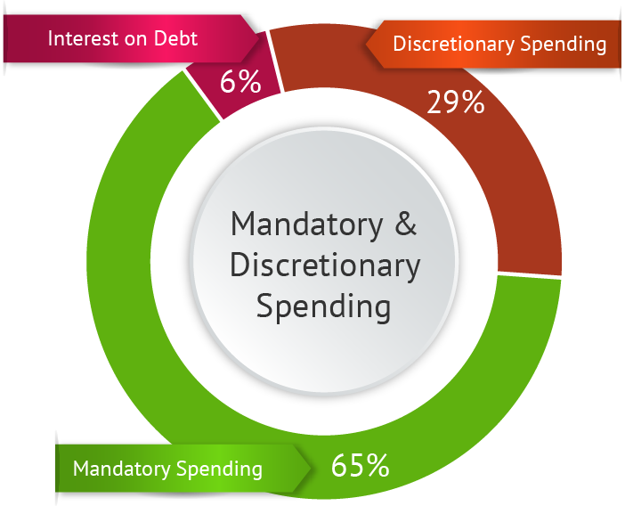
Where Your Tax Dollars Go
Government, Introduction to Taxes - Financial Wellness Presentation

Slide 10
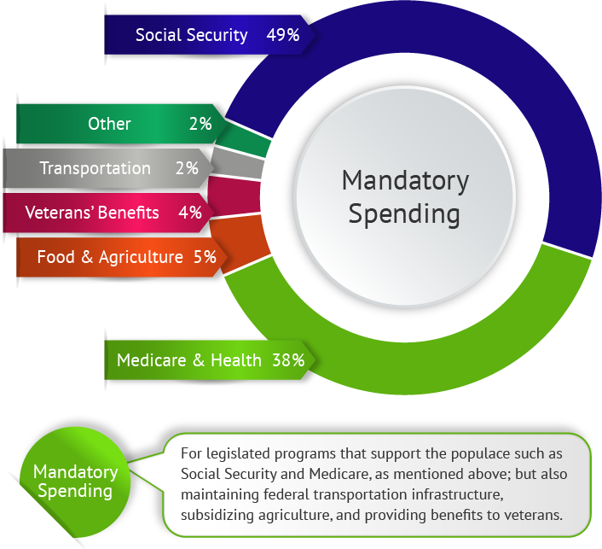
Where Your Tax Dollars Go
Government, Introduction to Taxes - Financial Wellness Presentation

Slide 11
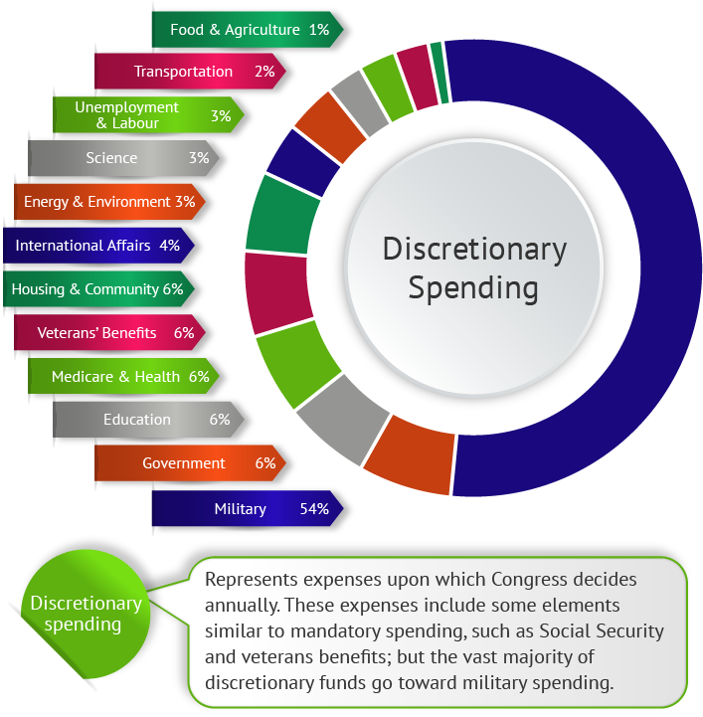
Where Your Tax Dollars Go
Government, Introduction to Taxes - Financial Wellness Presentation

Slide 12

Final Thoughts
Continue learning more about taxes
Gain skills to create an individualized tax plan aligned with your goals
Make it an objective to legally minimize your tax burden over your lifetime
Build a trusted team of advisors
Government, Introduction to Taxes - Financial Wellness Presentation

Slide 13
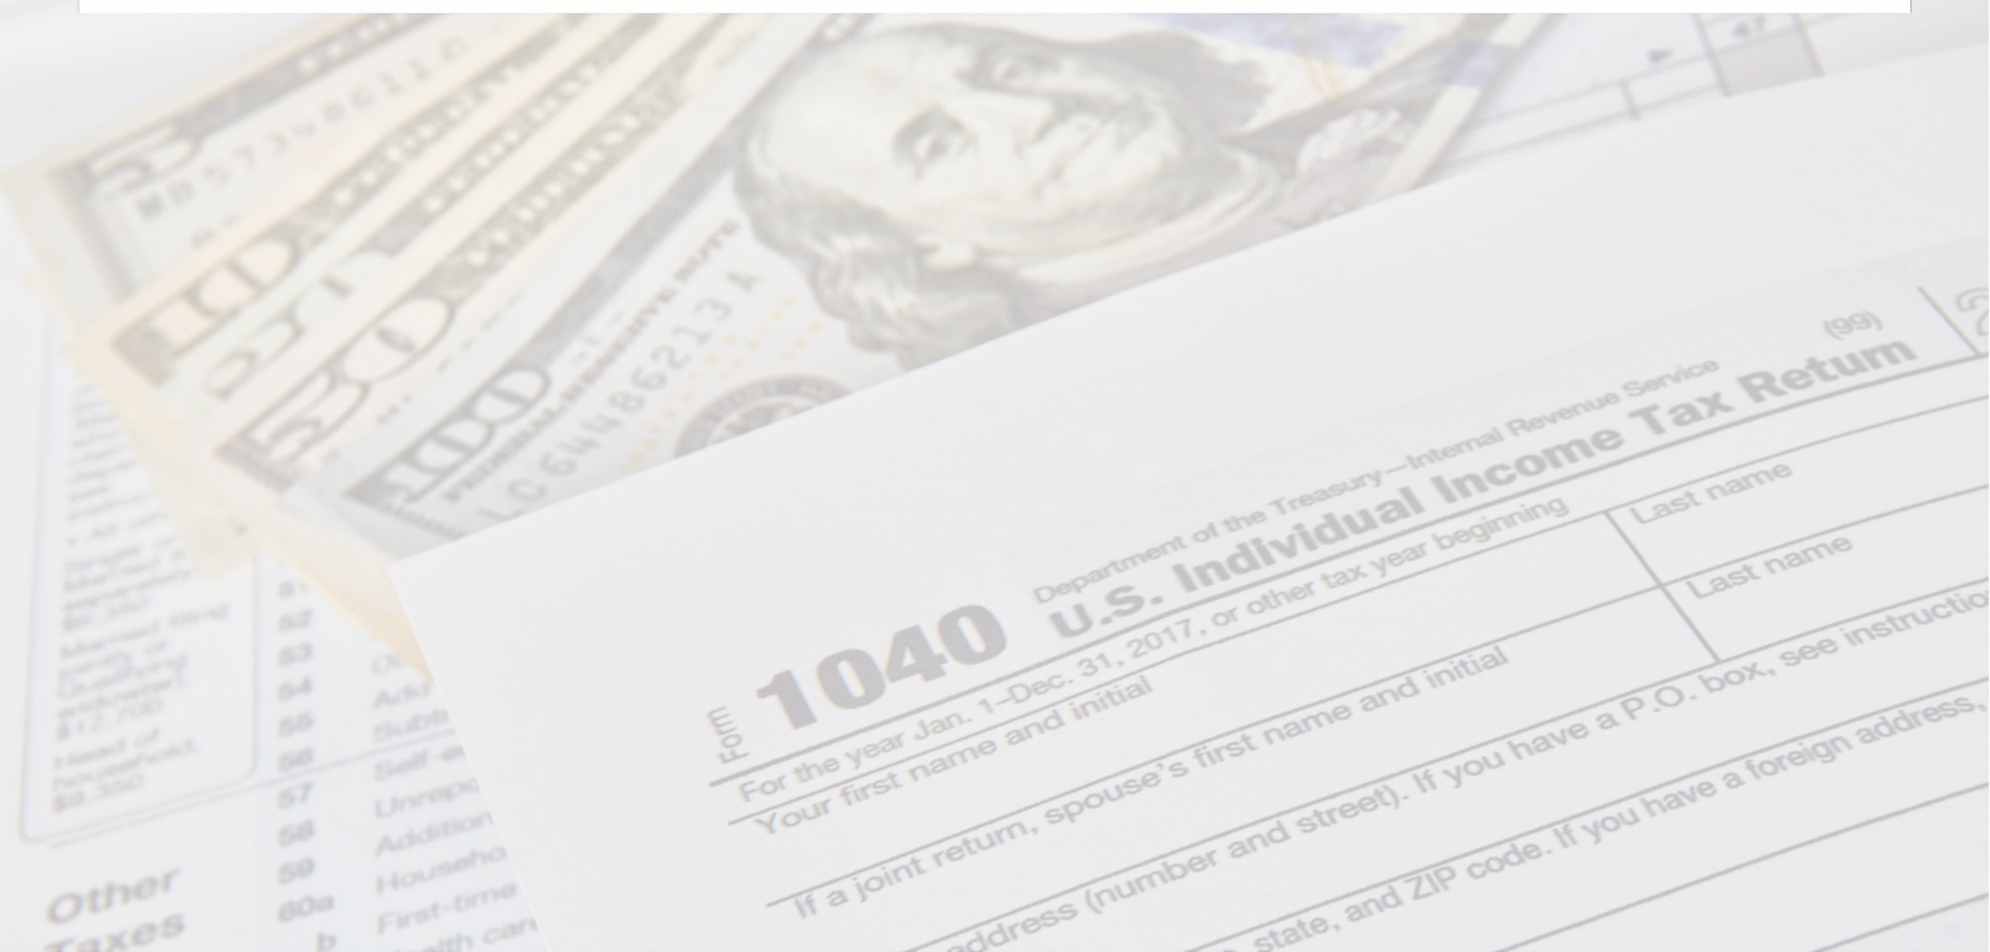
Government, Income Taxes
Financial Wellness Presentation

Slide 14
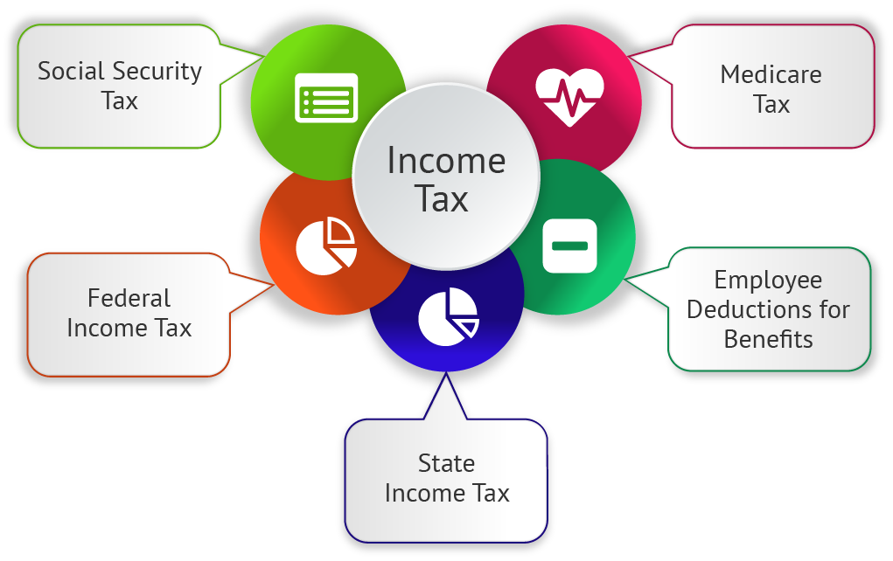
Government, Income Taxes - Financial Wellness Presentation

Slide 15

Understanding Your Paycheck
Federal Tax
  Based on a graduated system
  Different income brackets taxed at different rates
FICA Taxes
  Social Security
  Medicare
State Tax
  Tax rate varies by state
  Only seven states currently have no income tax
Government, Income Taxes - Financial Wellness Presentation

Slide 16
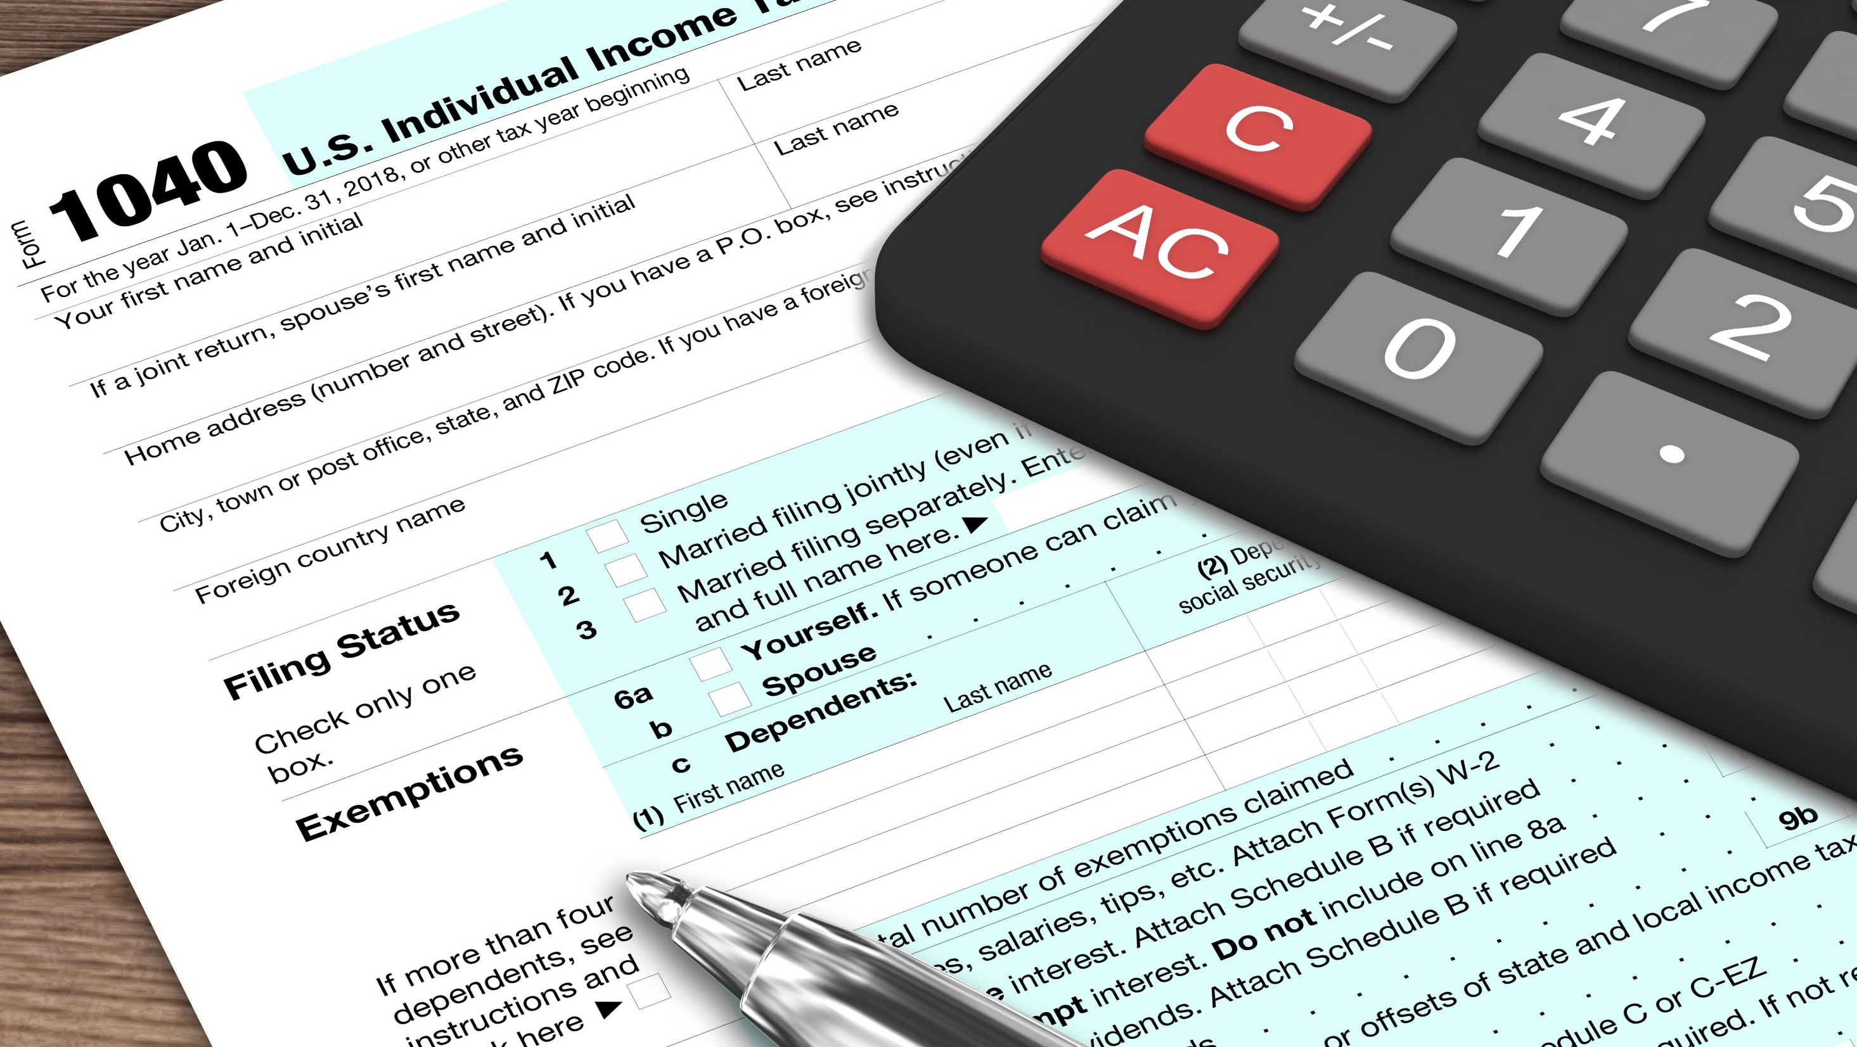
Understanding Your Paycheck
Other Possible Deductions
  Retirement contributions
  Health insurance costs
  Dental insurance
  Life insurance
  Disability income insurance

Slide 17
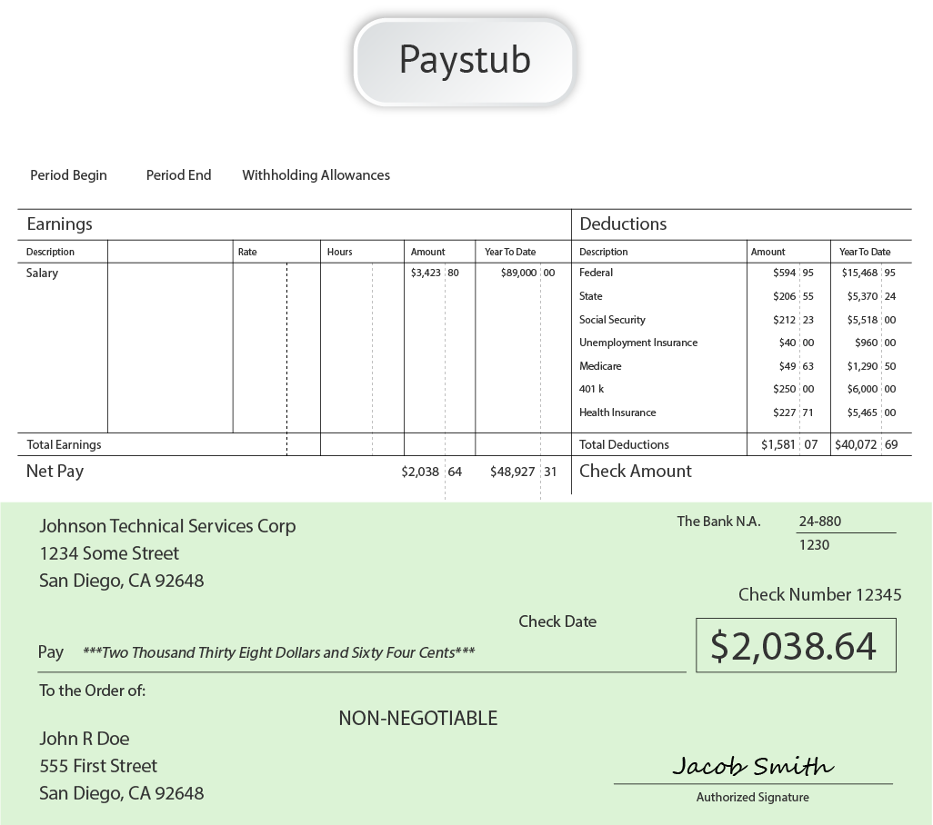
Your Paystub
Government, Income Taxes - Financial Wellness Presentation

Slide 18
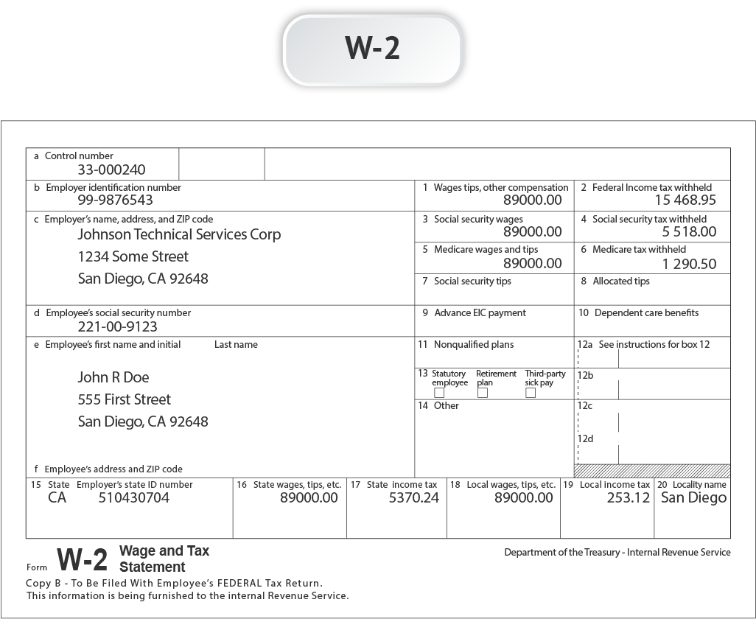
W2 Form
Government, Income Taxes - Financial Wellness Presentation

Slide 19
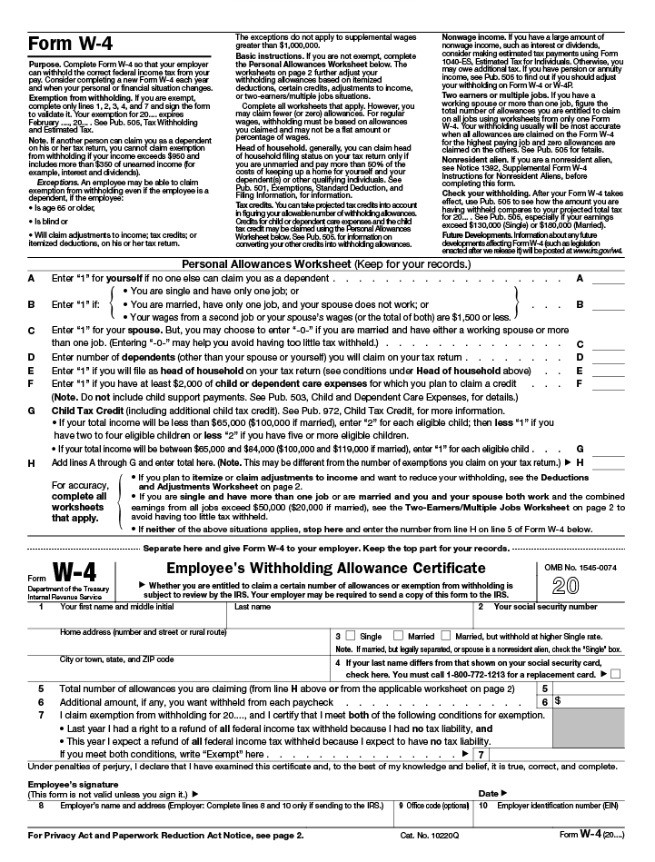
W4 Form
Government, Income Taxes - Financial Wellness Presentation

Slide 20
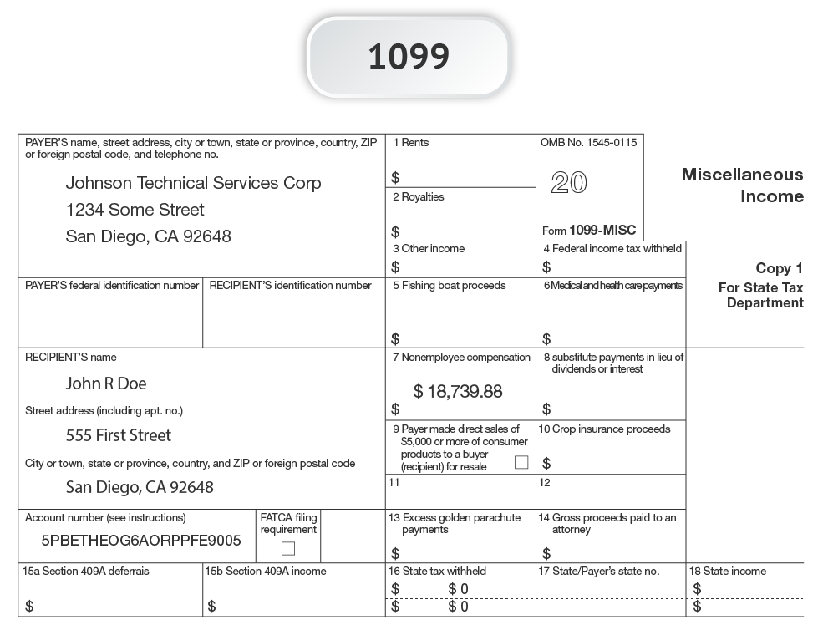
1099 Form
Government, Income Taxes - Financial Wellness Presentation

Slide 21

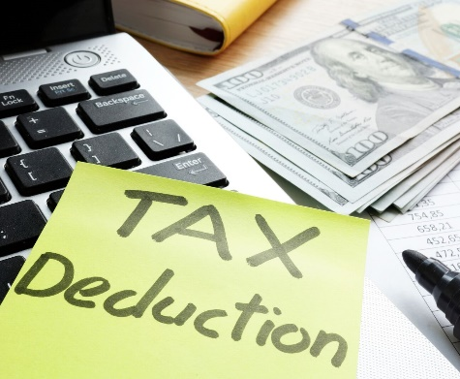

Changing Your Tax Deductions
If you get refunds or have to pay taxes every year, you may consider adjusting your withholdings
If employed, file a new W4 with your employer
If you’re a contractor or business owner, your taxes are not automatically taken out of your earnings
  You may receive 1099 forms
  You must pay estimated taxes quarterly
Check with your tax professional before making changes
Government, Income Taxes - Financial Wellness Presentation

Slide 22

Under- Or Overpayment Of Income Taxes
Underpayment
  You will have to pay the IRS any underpaid taxes you owe
  You will also have to pay penalties and fees
  The penalties and fees are quite high
Overpayment
  You are essentially lending the government money
  You don’t earn any interest on that money
  Consider adjusting your withholdings so you can keep that money in an interest-bearing account
Government, Income Taxes - Financial Wellness Presentation

Slide 23

Final Thoughts
Income tax is a significant piece of your budget
Review your paystubs carefully to make sure you know where your money is going
Plan to manage your income tax burden in a way that aligns with your goals
Consult with a tax professional
Government, Income Taxes - Financial Wellness Presentation

