Slide 1

Savings, Expenses & Budgeting

Slide 2

Major Expenses – Renting a Home
Major Expenses - Renting a Home
Budgeting

Slide 3
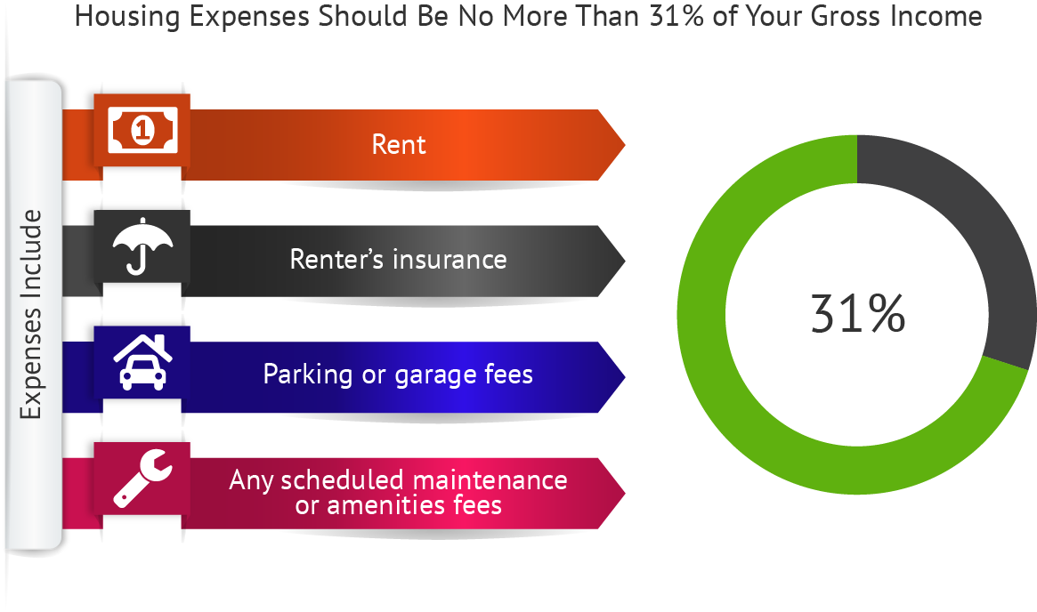
Costs Involved in Renting a Home
Major Expenses - Renting a Home
Budgeting

Slide 4

Other Monthly Expenses Associated with Renting
Utilities
  Gas/Electric
  Water
  Trash removal
Cable or Satellite TV
Internet
Security Systems
Appliance Maintenance
Major Expenses - Renting a Home
Budgeting

Slide 5

Up-front Rental Investment
First and last months’ rent
Security deposit
Additional up-front fees:
  Utility setup charges
  Moving costs
  Furniture and appliance costs
Be mindful of emotional purchases!
Major Expenses - Renting a Home
Budgeting

Slide 6

Qualifying to Rent
Landlords look at several factors:
  Income
  Credit history
  Rental history
  Criminal background
  Pets
Managing your finances well and staying out of trouble will help you qualify.
Major Expenses - Renting a Home
Budgeting

Slide 7

Tips for Finding a Rental
Budget first
Are you “rent-ready?”
Research your target location
Decide on features you need
Locate a few options
Develop and practice your contact etiquette
Inspect the property closely
Take photo series or video
Know what you’re signing
If you’re a good tenant – negotiate!
Major Expenses - Renting a Home
Budgeting

Slide 8

Questions to Ask Yourself
Do I know the features I need?
Do I have enough money for the up-front investment?
Do I have furniture, bedding, equipment?
Can I pay the rent without a single late payment?
Do I have references and proof of income?
Can I deal appropriately with landlords and agents?
Do I understand tenant rights and responsibilities?
Can I fill out a condition report accurately and fully?
Can I keep good records?
Can I manage household tasks?
Can I get along with neighbors?
Major Expenses - Renting a Home
Budgeting

Slide 9

Benefits of Budgeting
Gives you control over your money
Keeps you focused toward your financial goals
Helps you stay aware of where your money goes
Helps you save for expected and unexpected costs
Clarifies areas where you can save money
Budgeting Fundamentals & Overview
Budgeting

Slide 10

Budgeting Fundamentals & Overview
Budgeting Fundamentals & Overview
Budgeting

Slide 11
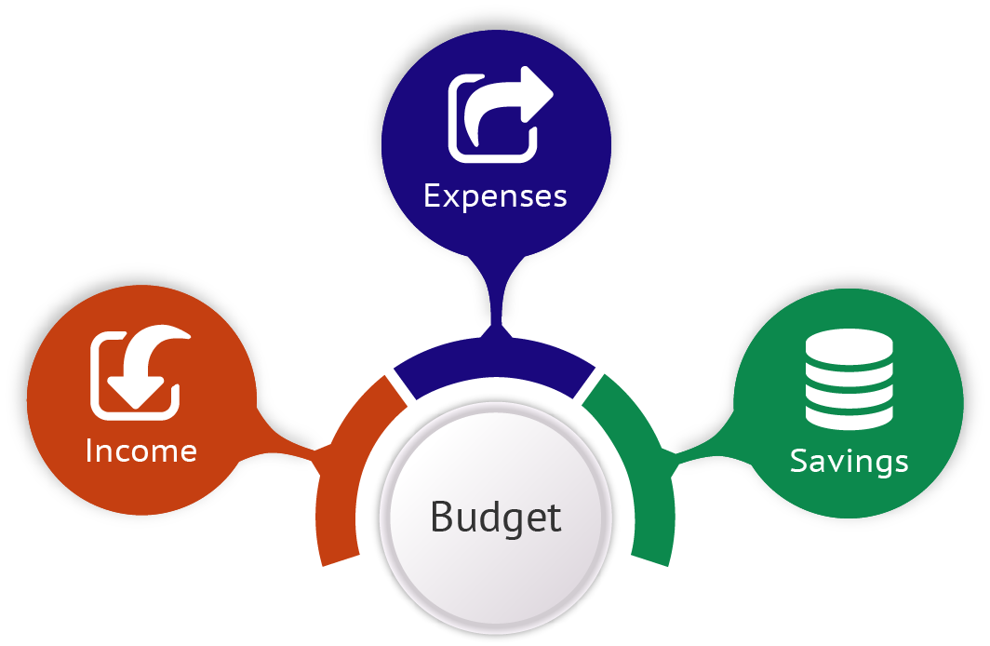
Definition of a Budget
“A finance plan that allocates future personal income toward expenses, savings, and debt repayment.”
Budgeting Fundamentals & Overview
Budgeting

Slide 12



Three Main Components of a Budget
Income
Money you earn from a range of sources.
Expenses
Outgoing funds you pay to others
Savings
Anything you have left over after paying your expenses.
Budgeting
Budgeting Fundamentals & Overview
Budgeting

Slide 13
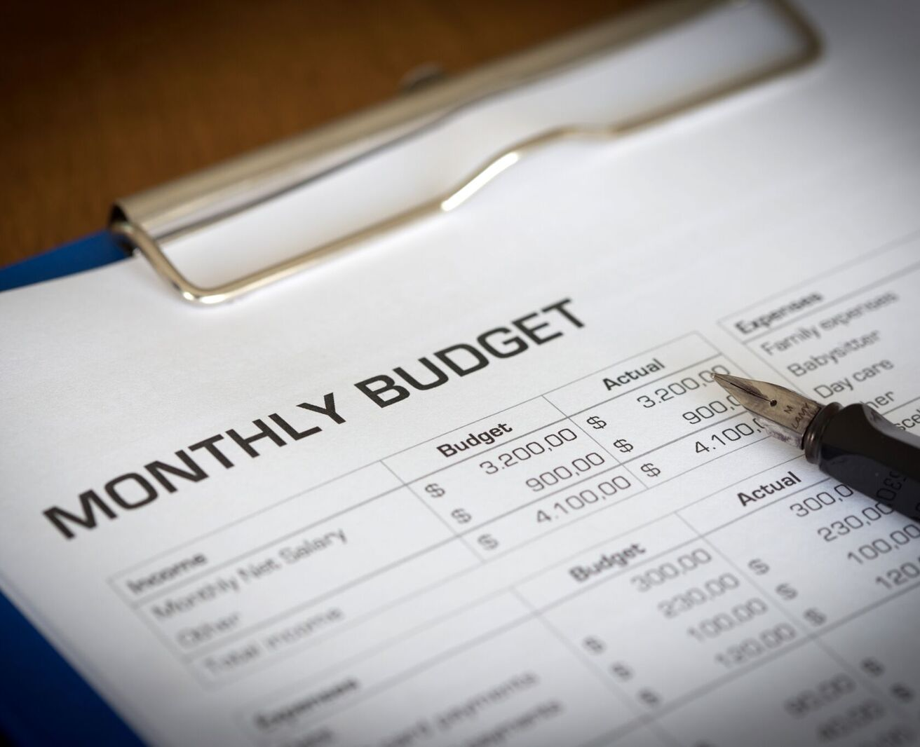
Where to Start when Developing a Budget
Understand your money and how you spend it
Make tough decisions about spending priorities
Budget with a lifestyle in mind
Build a budget that allows you to save
Budgeting Fundamentals & Overview
Budgeting

Slide 14

Budgeting With A Lifestyle In Mind
Clarify the life aspects you give priority, and then split them into 3 areas:
Items that create meaning and bring you joy
Things you want, but that can wait
Things you would like to have, but aren’t essential
Budgeting Fundamentals & Overview
Budgeting

Slide 15

Things to Remember about Budgeting
Make sure your list reflects your priorities
You can always adjust your goals as your priorities change
Budgeting takes time, patience, and effort
If your first attempts don’t go as planned, don’t give up
Look for ways to make tracking spending easier – like mobile apps
Budgeting Fundamentals & Overview
Budgeting
Notes:
https://www.dropbox.com/sh/divlqzpn4e6tumz/AADx0mM9kK20y5D9m8J4IIf-a/Grab%20Batch%20Pics%2010%20Chapter%202/iStock-494146669.jpg?dl=0

Slide 16

What Happens if you Don’t Budget
Overspending
Falling into a debt cycle
Limited spending power
Limited savings and investments
Lack of future security
Budgeting Fundamentals & Overview
Budgeting

Slide 17

Finally…
Budgeting is about saving money
Better budgeting helps you end up with more money to manage
An accurate budget brings discipline and order to your finances
Use your budget to guide important decisions
Earning more than you spend is the way to a low-stress, comfortable life!

Slide 18

Setting Savings Goals And Creating A Savings Plan
Setting Savings Goals & Creating a Savings Plan
Budgeting

Slide 19
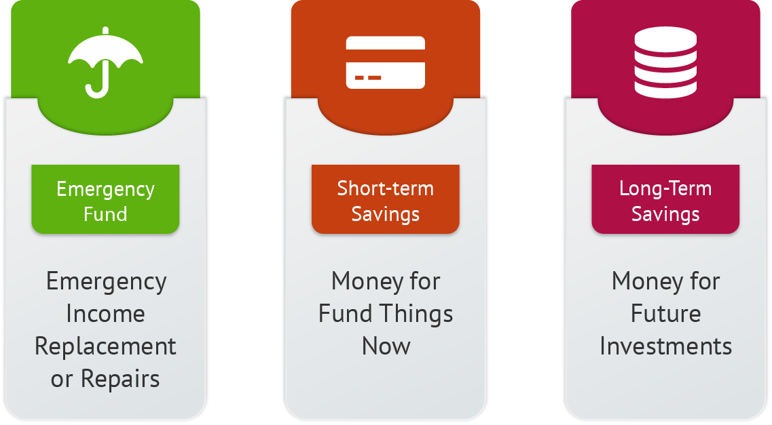
Three Components of a Savings Plan
Setting Savings Goals & Creating a Savings Plan
Budgeting

Slide 20

Emergency Fund
Should be liquid (easily converted to cash)
Equal to at least 6 months of your essential living expenses
Those in downsizing or highly competitive industries should save more
Be prepared for a market collapse
Cushion for handling unexpected expenses
Setting Savings Goals & Creating a Savings Plan
Budgeting

Slide 21
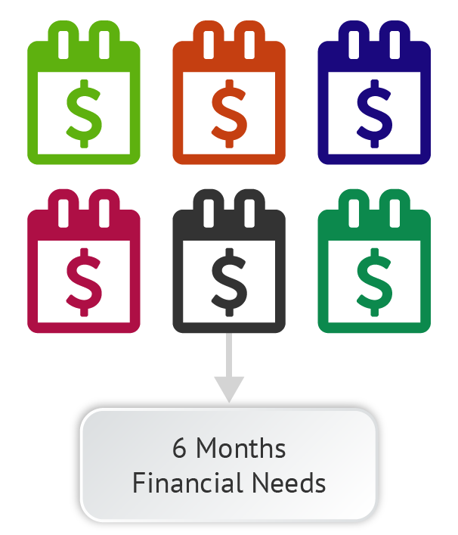
Simple Emergency Fund Calculation
  A simple calculation is to multiply your monthly financial needs by 6
Setting Savings Goals & Creating a Savings Plan
Budgeting

Slide 22
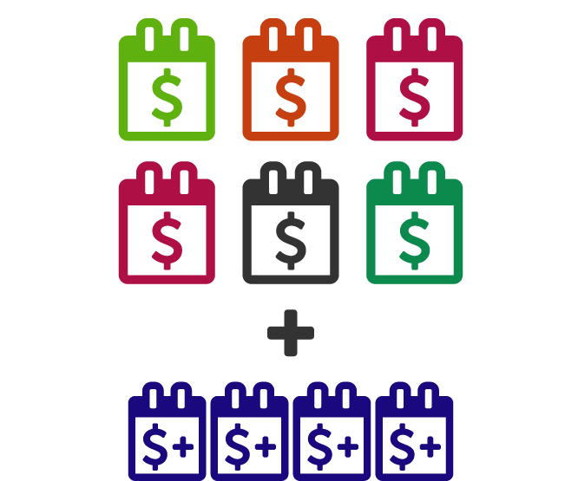
Advanced Emergency Fund Calculation
Consider the amount of tima it would take you to replace your income source if that soure were lost. Set aside at least 6 months’ worth of expenses, plus expenses for the time it would take to replace your income source.
Setting Savings Goals & Creating a Savings Plan
Budgeting

Slide 23

When should you use your emergency fund?
Sudden unemployment
Replace things you must have to make money
Emergency medical expenses
Disaster recovery
Deductibles in case of accident or loss
Repairs that would result in further damage if neglected
Unexpected expenses:
  Was it impossible to plan for?
  Is it urgent?
Setting Savings Goals & Creating a Savings Plan
Budgeting

Slide 24
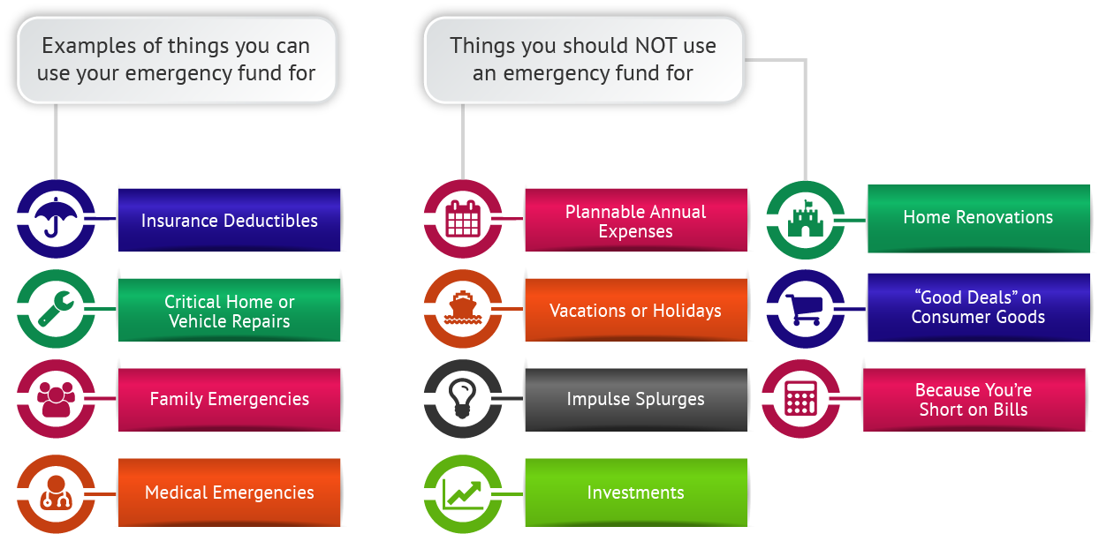
Deciding When to Use Your Emergency Fund
Setting Savings Goals & Creating a Savings Plan
Budgeting

Slide 25

Short-term Savings
Money set aside for fun things now
Enjoy the fruits of your labor
Provides near-term gratification without going into debt
Gets you in the habit of evaluating and prioritizing your wants

Slide 26

Long-term Savings
Money for future investments
Long-term financial plans, such as retirement
“Pay yourself first”
Target 10% of your take-home income
Increase the amount over time
Use automatic transfers to make long-term savings routine
Setting Savings Goals & Creating a Savings Plan
Budgeting

Slide 27
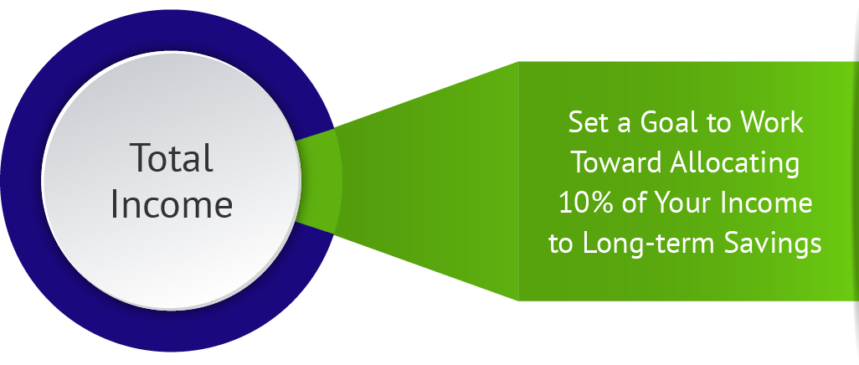
Setting a Long-term Savings Goal
Setting Savings Goals & Creating a Savings Plan
Budgeting

Slide 28

Factors to Consider
Find out the real cost of unemployment in your industry
Caring for aging family members
Debt load vs. your savings or investment returns
Two simple ways to save more money:
  Increase income
  Cut down on expenses
Setting Savings Goals & Creating a Savings Plan
Budgeting

Slide 29

Developing an Individualized Savings Plan
Set emergency fund targets
  Decide on the standard of living you’ll maintain during unemployment
Short-term savings targets
  What major expenses are coming up?
  How much do you have saved now?
  When do you need them?
Long-term savings targets
  Shoot for saving 10% of your net income
Setting Savings Goals & Creating a Savings Plan
Budgeting

Slide 30

Create Your Budget & Automate
Create Your Budget & Automate
Budgeting

Slide 31
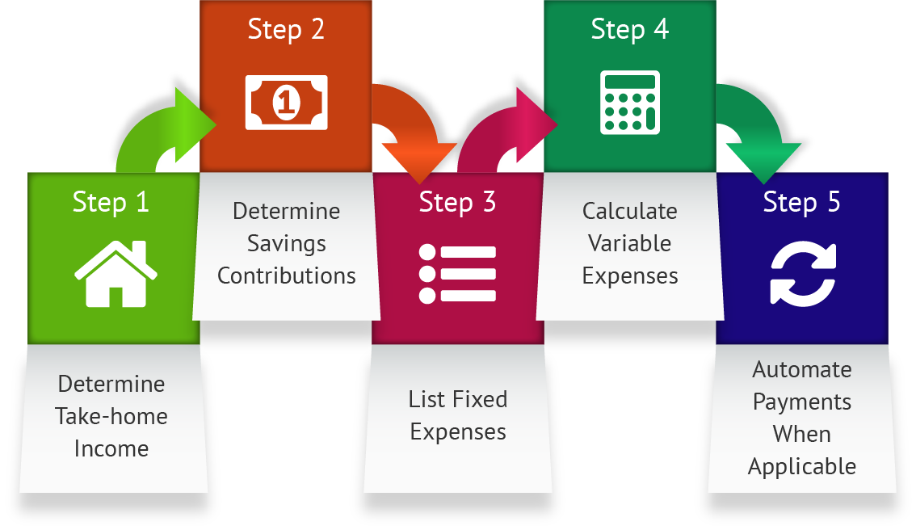
Steps in Creating a Budget
Create Your Budget & Automate
Budgeting

Slide 32

Budget Components
Income
  Take-home pay from work; tips; any other compensation.
Savings
  Set aside at least 10% of your total income.
Fixed expenses
  Bills you pay the same amount each month (rent, car payment, insurance); for bills you pay annually, divide by 12 to enter monthly amount.
Variable expenses
  Bills where the amount varies each month (e.g. utilities based on usage), including incidental expenses (coffee, movies, events).
Bottom line
  Anything left over can be used to purchase “wants.”
Create Your Budget & Automate
Budgeting
Notes:
https://www.dropbox.com/sh/qludafbi6vrosk2/AAD015KNizS9oihpihIUpBtUa/iStock-137925642.jpg?dl=0

Slide 33



Budget Step 1
  Enter your income – Total net (take-home) pay, tips, and any other compensation.
Budget Step 2
  Plan your savings – Set aside at least 10% of your income before you purchase any “wants.”
Budget Step 3
  List fixed expenses – Rent, car payment, insurance. Account for annual fixed expenses (gym memberships, auto registration, etc.) by dividing the annual payment by 12.
Budget Step 4
  Calculate variable expenses – Coffee, movies, special events. Track variable expenses for a month and adjust accordingly.
Budget Step 5
  Set up your budget to automate and organize your finances online. This step will ensure that you can accurately monitor your budget and make adjustments.
Create Your Budget & Automate
Budgeting

Slide 34
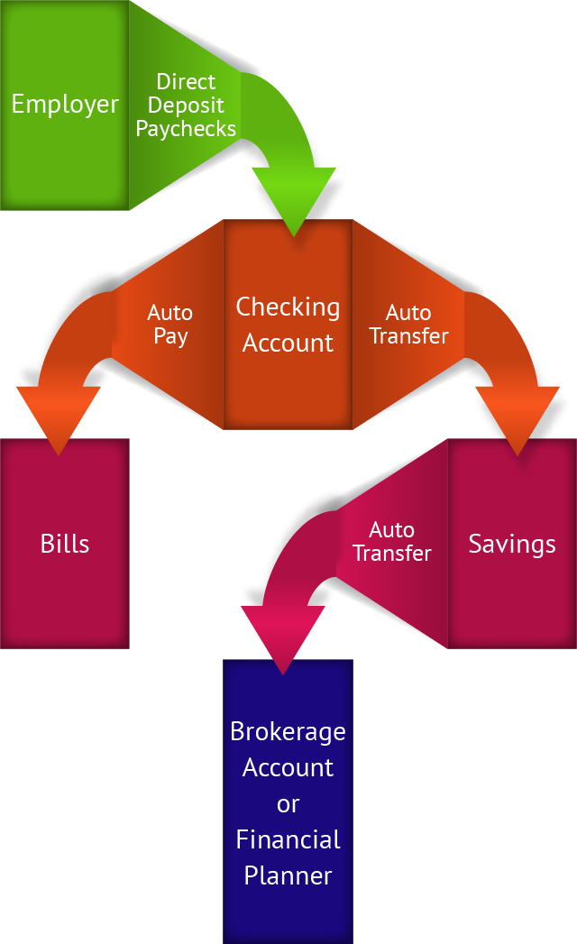
Set up Automated Accounts
Choose a financial institution
Set up checking and savings accounts
Set up direct deposit for your paychecks
Automate your bill payments
“Pay yourself” first by contributing to savings via automatic transfer
What’s left over?
Create Your Budget & Automate
Budgeting

Slide 35

Third-party Financial Tracking Systems
Allow you to connect all accounts on a single dashboard.
Pose two types of risk:
  Advertising exposure
  Account compromise
Carefully review advertising before buying to ensure that products are right for you.
Vary your user names and passwords between accounts to protect yourself from attackers.
Create Your Budget & Automate
Budgeting

Slide 36

Analyzing Your Budget & Addressing Gaps
Analyzing Your Budget & Addressing Gaps
Budgeting

Slide 37
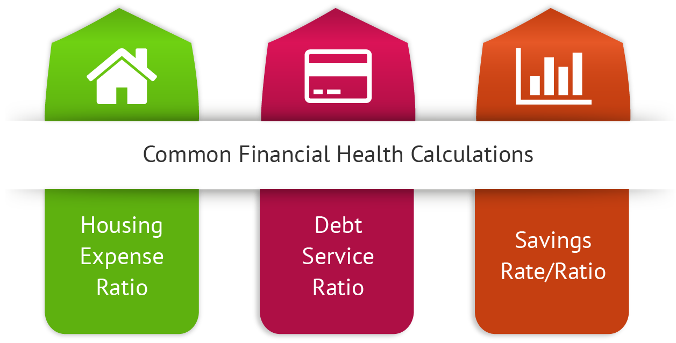
Analyzing Your Budget & Addressing Gaps
Budgeting

Slide 38

Regular Budget Review has Many Benefits
Income, expenses, and savings goals change over time
Check accuracy of your estimates
Identify areas where you need to make changes
Know where your money’s going
Determine how much to allocate for the future
Analyzing Your Budget & Addressing Gaps
Budgeting
Notes:
https://www.dropbox.com/sh/divlqzpn4e6tumz/AADpXx8vs6Nbyyv2GinksJjta?dl=0&file_subpath=%2F2.6+images%2FiStock-515472156.jpg&preview=2.6+images.zip

Slide 39
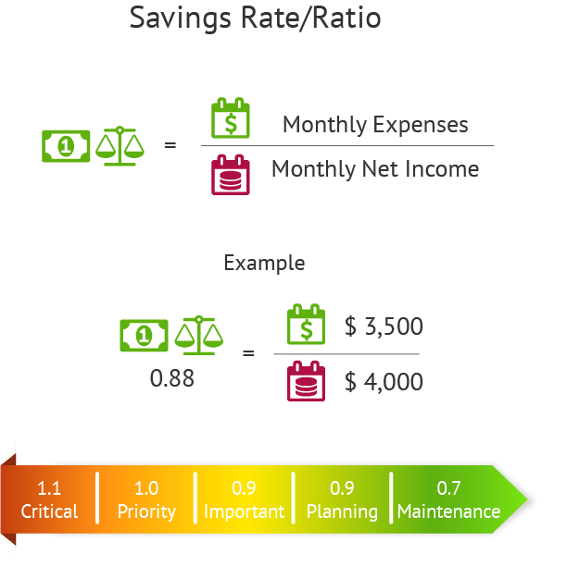
Savings Rate Ratio
Total expenses / net income
The lower your ratio, the better
Analyzing Your Budget & Addressing Gaps
Budgeting

Slide 40

Debt Service Ratio
Two aspects:
  Total debt ratio
  Housing expense ratio
Used by lenders to qualify you for loans
High debt in proportion to income indicates that you may have trouble paying the debt
High debt makes you vulnerable to unknowns
Beware of lengthy loan terms
Analyzing Your Budget & Addressing Gaps
Budgeting

Slide 41
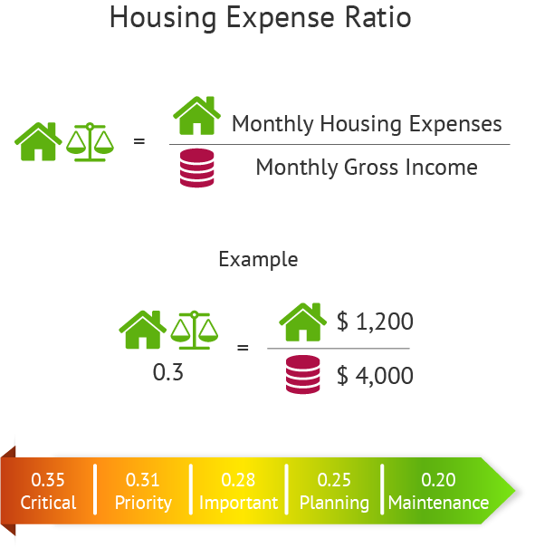
Housing Expense to Income Ratio
Total monthly housing cost / gross income
Homeowners’ monthly housing costs include:
  Principal payment
  Interest
  Property taxes
  Association fees
Renters’ monthly housing costs include:
  Rent
  Renter’s insurance
  Parking fees
  Scheduled maintenance or amenities fees
Analyzing Your Budget & Addressing Gaps
Budgeting

Slide 42

Total Debt to Income Ratio
Total obligated debt / gross income
Total obligated debt includes:
  Mortgage or rent payment
  Credit cards
  Installment loans
  Car loans
  Student loans
  Consumer lines of credit
  Any other payment that shows up on your credit report
Analyzing Your Budget & Addressing Gaps
Budgeting

Slide 43

Understanding Your Credit Profile
Understanding Your Credit Profile
Credit Profile

Slide 44
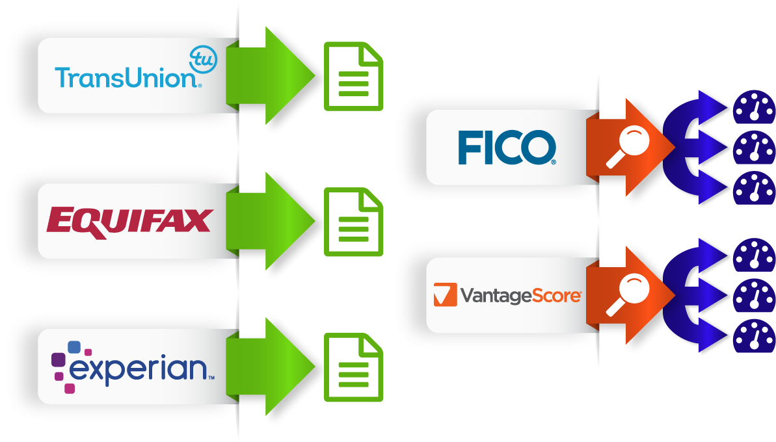
How The Credit Bureaus Produce Reports
Understanding Your Credit Profile
Credit Profile

Slide 45

Credit Reports Include The Following Information About Each Account
Date opened
Type of account – installment vs. revolving
Joint or individual
Balance
When the last payment was made
Any past due information
Limit
Any additional terms
Account status – current/open, closed, charged off, sent for collection
Understanding Your Credit Profile
Credit Profile

Slide 46

Credit Score Calculations Are Determined By
Fair Isaac Corporation (FICO) –independent from the bureaus
VantageScore – joint venture among the bureaus

Slide 47
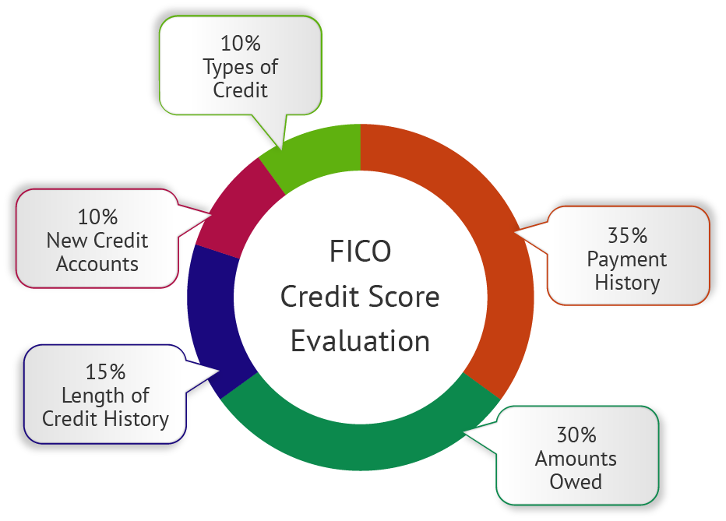
FICO Grading System
Understanding Your Credit Profile
Credit Profile

Slide 48
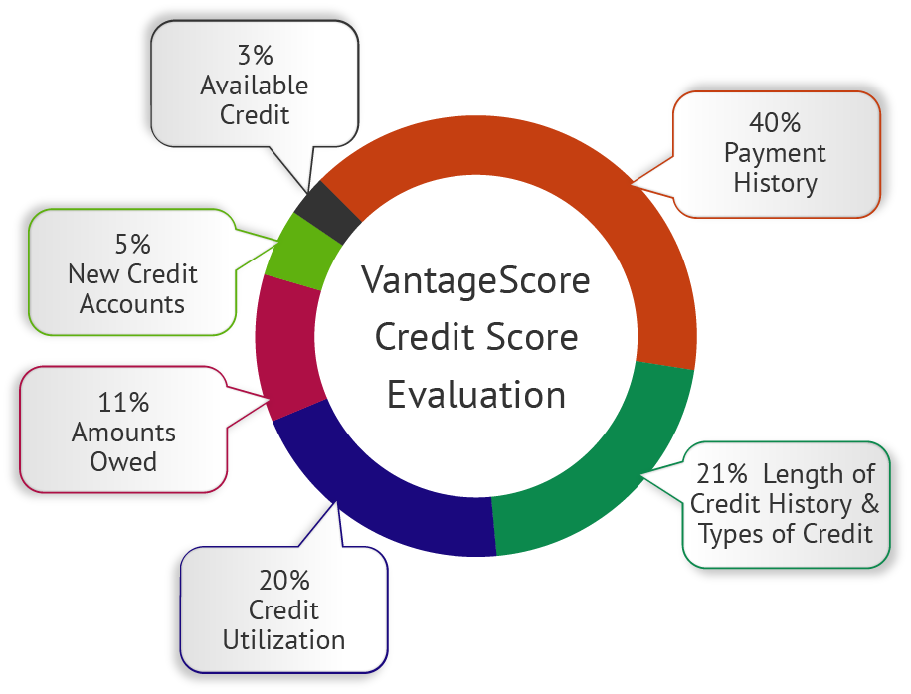
VantageScore Grading System
Understanding Your Credit Profile
Credit Profile

Slide 49
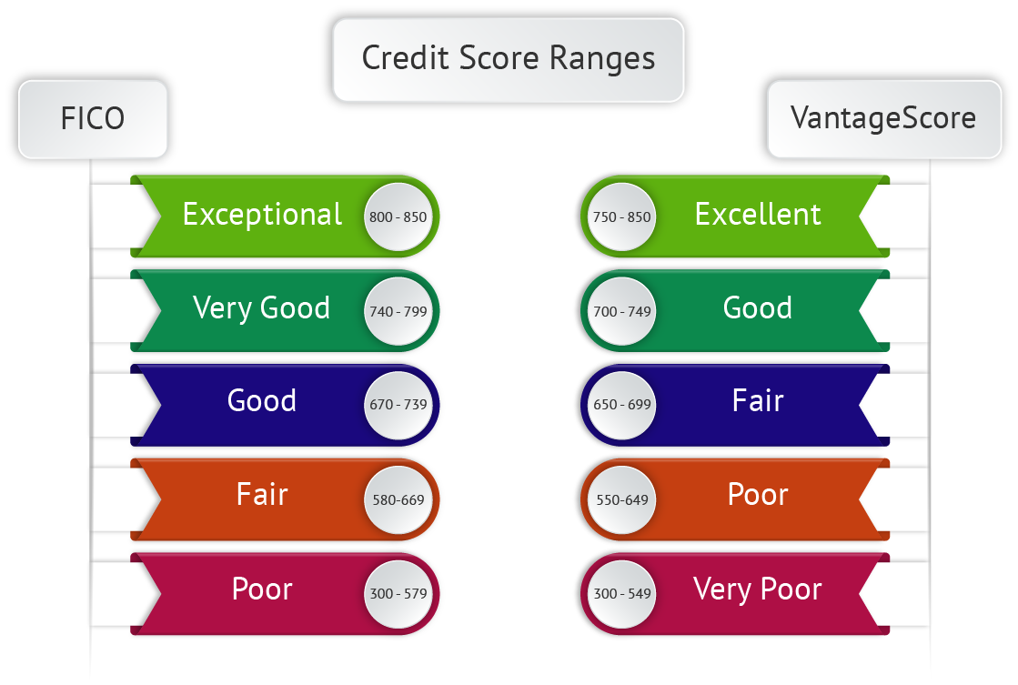
Understanding Your Credit Profile
Credit Profile

Slide 50

Tips For Getting And Keeping Great Credit
Pay all your bills on time
Keep debt low
Maintain a good credit score
Keep inquiries to a minimum
Have health and auto insurance
Check your credit once a year
Understanding Your Credit Profile
Credit Profile

Slide 51

Access Your Credit Report
Access Your Credit Report
Credit Profile

Slide 52
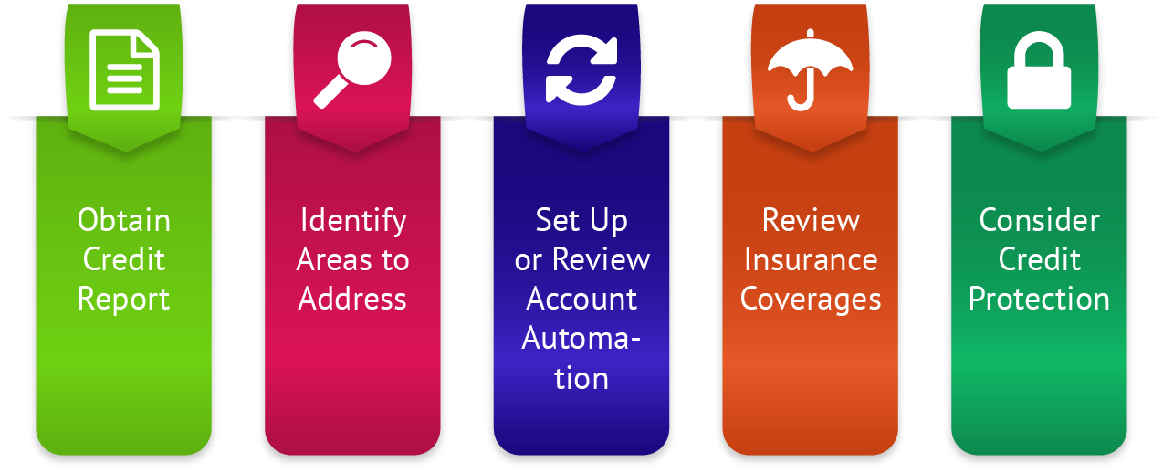
Elements Of A Credit Plan
Access Your Credit Report
Credit Profile

Slide 53

How To Obtain Your Credit Report
Go to AnnualCreditReport.com
Click on “Request your free credit reports”
Enter your personal information and click “next”
Choose the bureau from which to request your report
Verify information
Access your free report
Print or save as PDF file
Access Your Credit Report
Credit Profile

Slide 54

Sample Credit Plan
Credit Report
  Pull from all 3 bureaus at once
  Get one from each bureau every 4 months
Credit Score
  Free score from a company
  Purchase your accurate credit score
Review the data for accuracy
Start a credit report file
Look for trends and identify long-term solutions
Monitor regularly and set reminders
Access Your Credit Report
Credit Profile

Slide 55

Types Of Insurance & Which You Should Consider
Types of Insurance & Which You Should Consider
Insurance

Slide 56
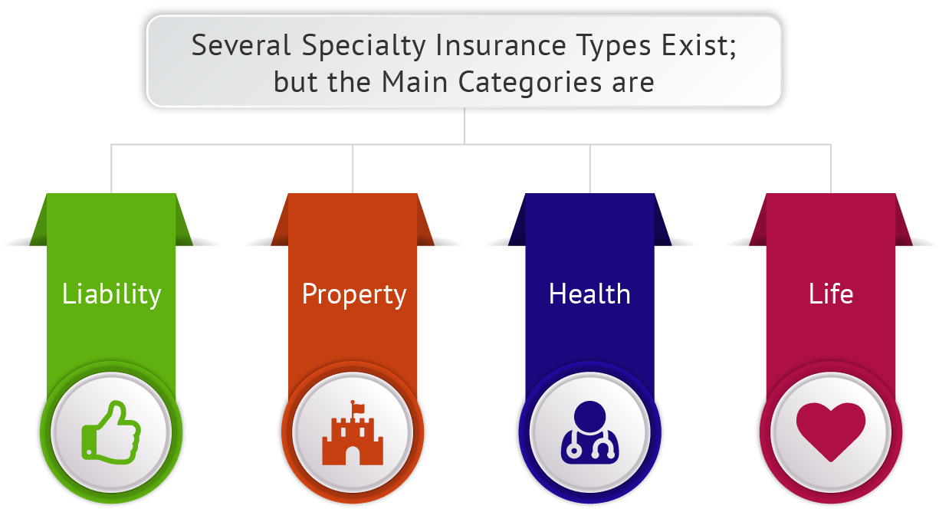
Types of Insurance & Which You Should Consider
Insurance

Slide 57
Four Primary Types Of Insurance
Liability insurance
Protects you from having to pay for injuries or damages caused to others
Property insurance
Covers your home or belongings
Health insurance
Protects you from unpredictable healthcare costs
Life insurance
Pays a benefit to your beneficiary(ies) upon your death
Types of Insurance & Which You Should Consider
Insurance

Slide 58

Renter’s Insurance
Compensates renters if their property is damaged, lost, or destroyed by a covered hazard (e.g. fire, water)
May protect against theft or vandalism
May include liability coverage to protect you from lawsuits

Slide 59

Basic Types Of Renter’s Insurance Coverage
Property/contents
  Contents of your rented space
Liability
  Damage you cause to the property or injury you cause to others, even if it doesn’t occur at home
Additional living expenses (ALE)
  Accommodations during damage repairs
Off-premises
  Losses you incur away from home
Types of Insurance & Which You Should Consider
Insurance

