Slide 1

Investing & Personal Financial Planning

Slide 2

Why People Invest
Why People Invest
Investing

Slide 3
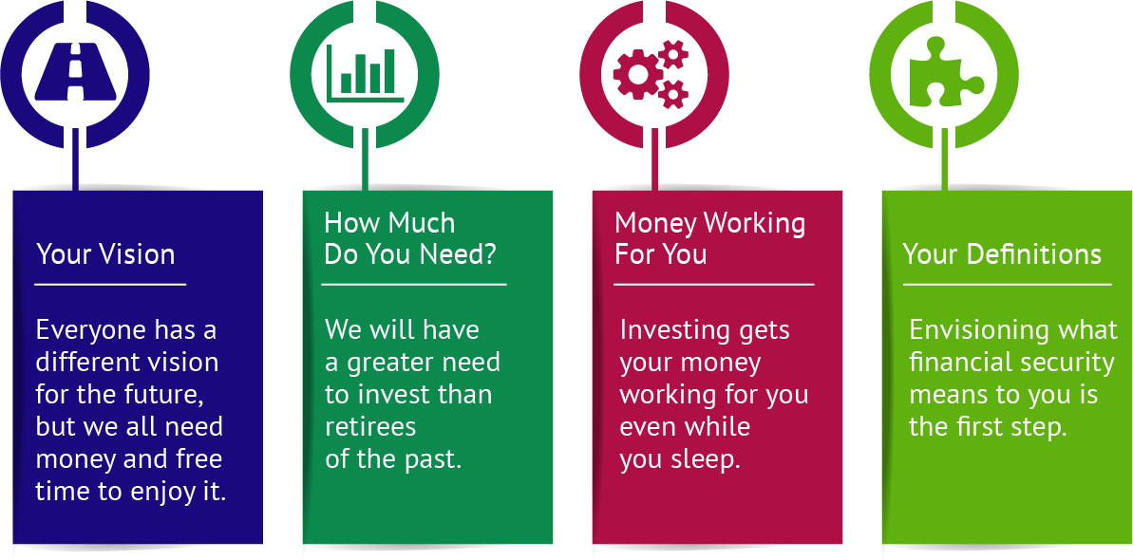
Why People Invest
Investing

Slide 4

Why People Decide to Learn About Investing
To become financially secure
Social Security and Medicare may not be available
To keep up with inflation
To achieve financial freedom
Gets your money working for you, rather than you having to work for every dollar
Why People Invest
Investing

Slide 5

Common Reasons to Invest
Be able to live desired lifestyle
Take care of family
Feel secure and independent
Rid yourself of worry and stress
Make a difference in the world
Purchase things like toys and travel
Why People Invest
Investing

Slide 6

Financial Independence Goal Barometers
Cash Flow
  Difference between money coming in and cash going out in an accounting period
Strive to have ‘positive cash flow’
Net Worth
  The measure of your net economic position; the difference between your assets and your liabilities
Why People Invest
Investing

Slide 7

Investment Risk
Investment Risk
Investing

Slide 8
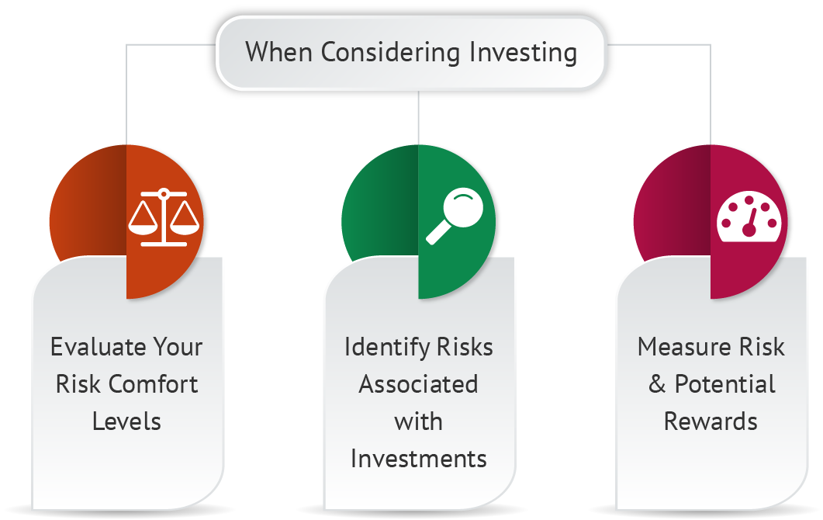
Investment Risk
Investing

Slide 9

What Is Risk?
The chance that an investment will not go as planned
You may lose money
You may get stuck in an investment and miss out on other opportunities
Risk typically increases earning potential:
  Low risk offers lower returns
  High risk usually has potential for higher returns
Investment Risk
Investing

Slide 10
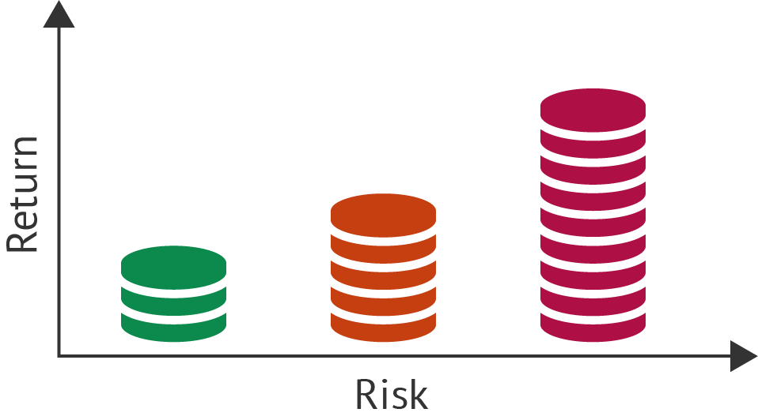
Investment Risk
Investing

Slide 11

Risk Tolerance
Different for each person
Consider your financial goals, age, family status, and current financial situation
Never invest money you cannot afford to lose
Plan and consult with your team to help minimize risk
Investing is a marathon, not a sprint – you should be in it for the long-term
Continue to gain knowledge and manage risk
Investment Risk
Investing

Slide 12
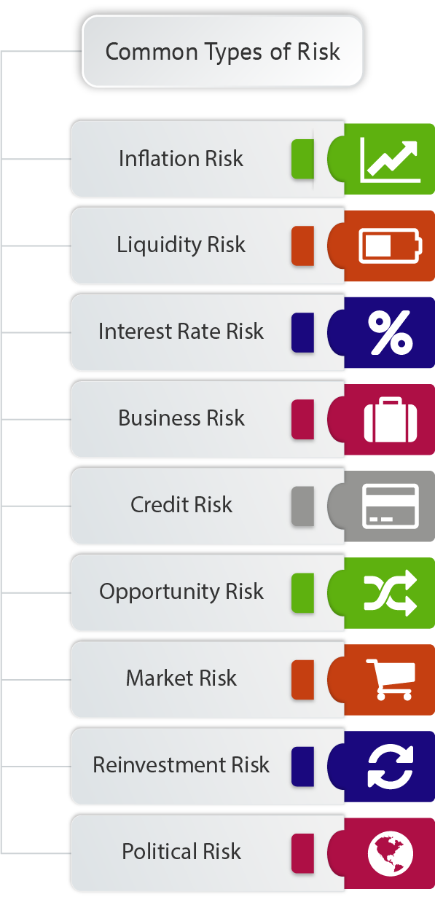
Common Types Of Risk
Investment Risk
Investing

Slide 13
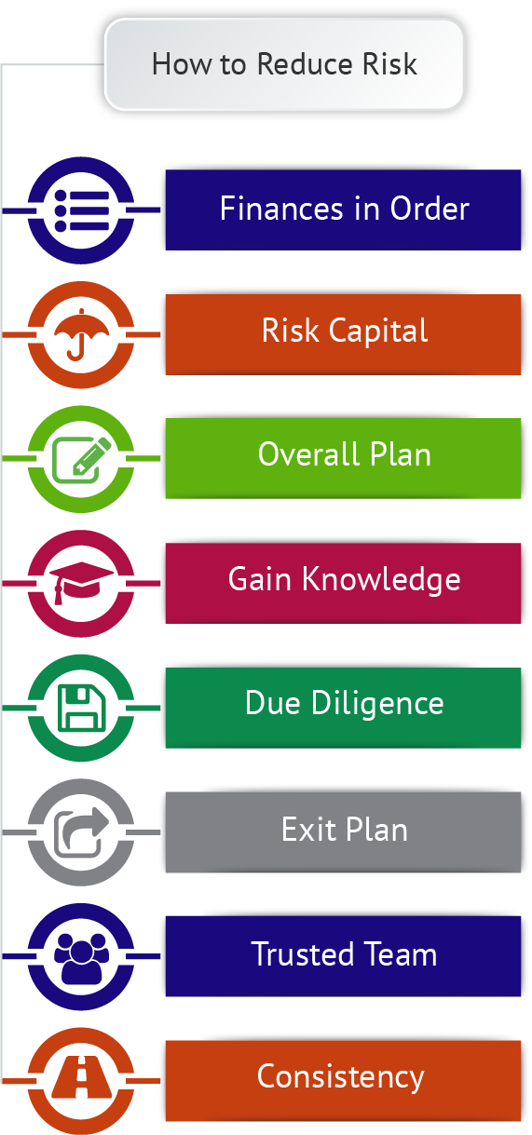
How To Reduce Risk
Investment Risk
Investing

Slide 14

Identifying Your Future Needs
Identifying Your Future Needs
Investing

Slide 15
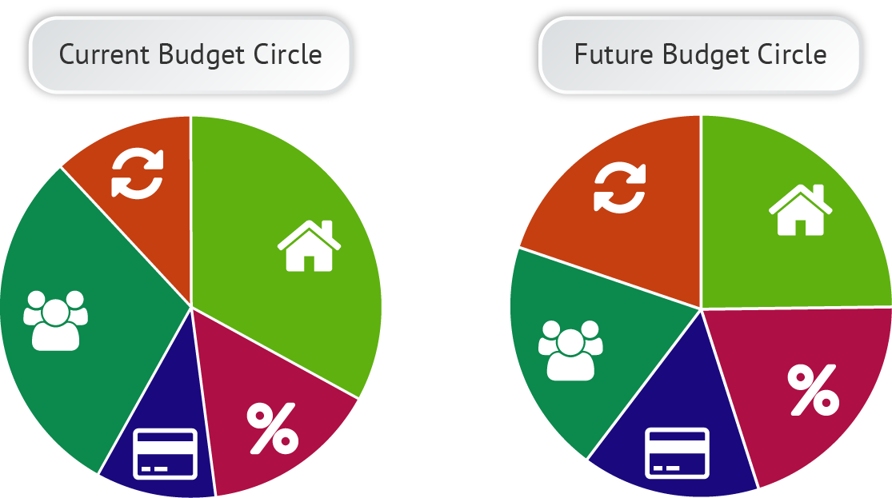
Identifying Your Future Needs
Investing

Slide 16



Steps To Creating A Future Budget
Estimate your future income: work, SSI, pension, IRAs, 401(k)
Plan your savings: at least 10% of your income set aside for the long-term
Estimate your future expenses
Account for inflation in your estimates
Identifying Your Future Needs
Investing

Slide 17
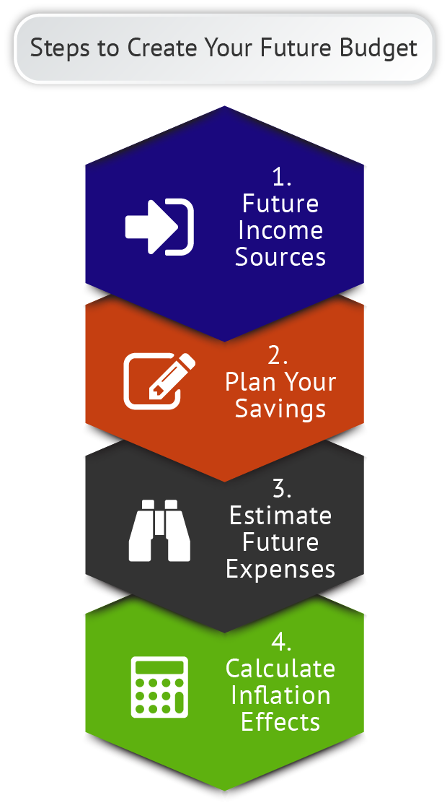
Steps To Create Your Future Budget
Identifying Your Future Needs
Investing

Slide 18

What Can A Dollar Buy?
1930s – full meal at an upscale restaurant
1940s – 20 bottles of Coke
1950s – four gallons of gas
1960s – movie ticket, popcorn, candy bar
1970s – two dozen eggs
1980s – two loaves of bread
1990s – a half-gallon of milk
2000s – one fast-food hamburger
2010s – one song download from iTunes
Identifying Your Future Needs
Investing

Slide 19

Accounting For Inflation
Inflation affects your money’s purchasing power over time
Historical annual average inflation is about 3%
So each year, your money loses 3% of its value
Creating a future budget that accounts for inflation helps you reach your long-term financial and lifestyle goals
Identifying Your Future Needs
Investing

