Slide 1

Savings, Expenses & Budgeting

Slide 2

Budgeting Fundamentals & Overview
Budgeting Fundamentals & Overview
Budgeting

Slide 3

Benefits of Budgeting
Gives you control over your money
Keeps you focused toward your financial goals
Helps you stay aware of where your money goes
Helps you save for expected and unexpected costs
Clarifies areas where you can save money
Budgeting Fundamentals & Overview
Budgeting

Slide 4
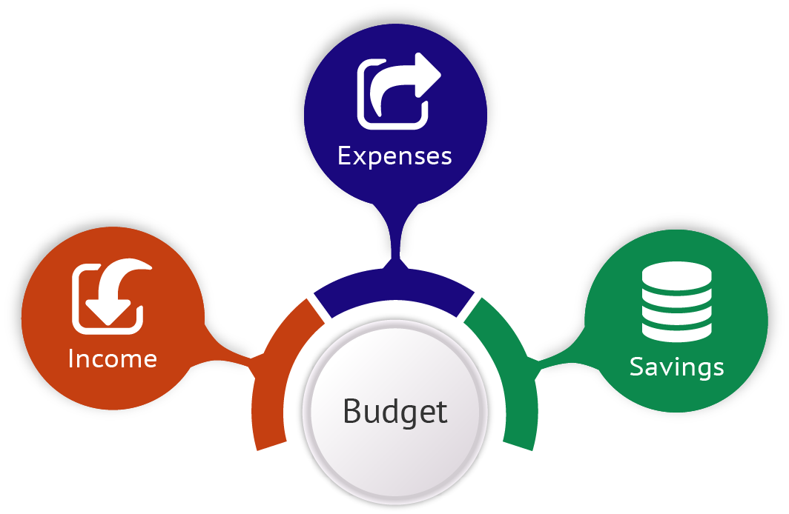
Definition of a Budget
“A finance plan that allocates future personal income toward expenses, savings, and debt repayment.”
Budgeting Fundamentals & Overview
Budgeting

Slide 5
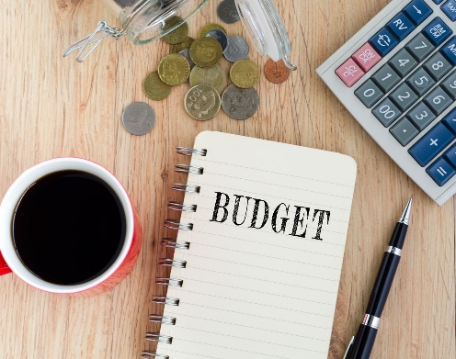


Three Main Components of a Budget
Income
Money you earn from a range of sources.
Expenses
Outgoing funds you pay to others
Savings
Anything you have left over after paying your expenses.
Budgeting
Budgeting Fundamentals & Overview
Budgeting

Slide 6
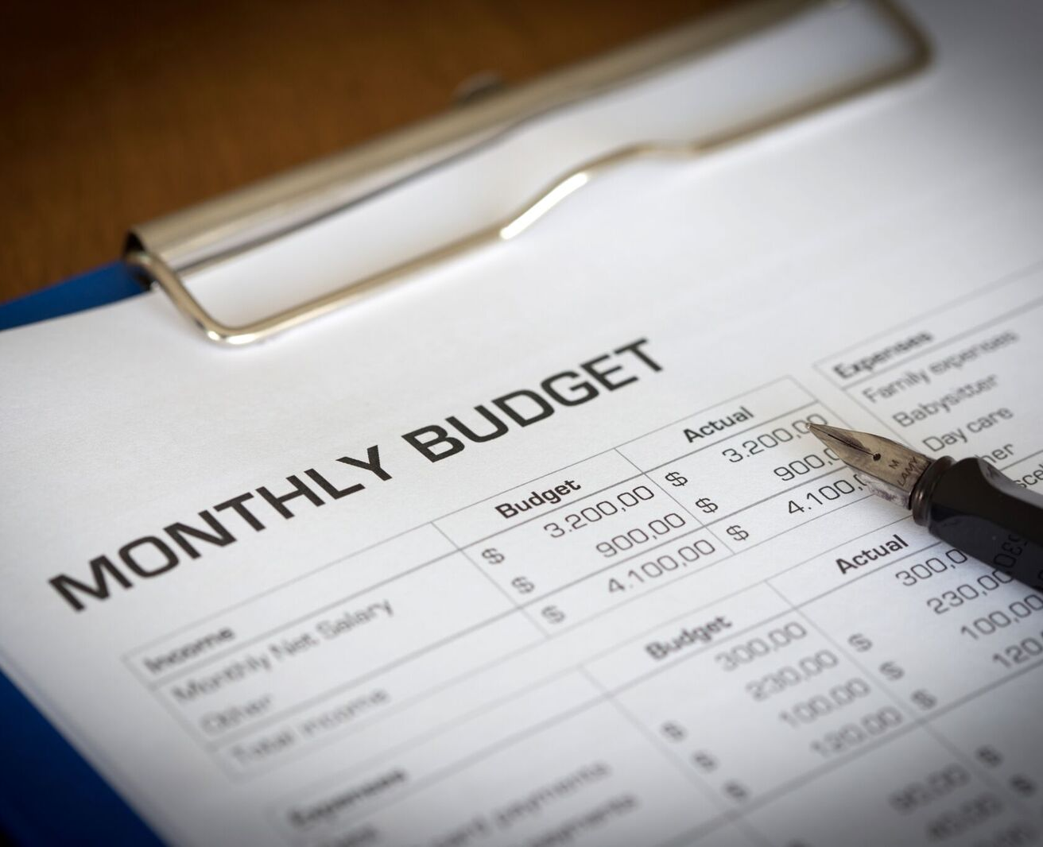
Where to Start when Developing a Budget
Understand your money and how you spend it
Make tough decisions about spending priorities
Budget with a lifestyle in mind
Build a budget that allows you to save
Budgeting Fundamentals & Overview
Budgeting

Slide 7

Budgeting With A Lifestyle In Mind
Clarify the life aspects you give priority, and then split them into 3 areas:
Items that create meaning and bring you joy
Things you want, but that can wait
Things you would like to have, but aren’t essential
Budgeting Fundamentals & Overview
Budgeting

Slide 8

Things to Remember about Budgeting
Make sure your list reflects your priorities
You can always adjust your goals as your priorities change
Budgeting takes time, patience, and effort
If your first attempts don’t go as planned, don’t give up
Look for ways to make tracking spending easier – like mobile apps
Budgeting Fundamentals & Overview
Budgeting
Notes:
https://www.dropbox.com/sh/divlqzpn4e6tumz/AADx0mM9kK20y5D9m8J4IIf-a/Grab%20Batch%20Pics%2010%20Chapter%202/iStock-494146669.jpg?dl=0

Slide 9

What Happens if you Don’t Budget
Overspending
Falling into a debt cycle
Limited spending power
Limited savings and investments
Lack of future security
Budgeting Fundamentals & Overview
Budgeting

Slide 10

Finally…
Budgeting is about saving money
Better budgeting helps you end up with more money to manage
An accurate budget brings discipline and order to your finances
Use your budget to guide important decisions
Earning more than you spend is the way to a low-stress, comfortable life!

Slide 11

Identifying and Reducing Your Expenses
Identifying & Reducing Your Expenses
Budgeting

Slide 12
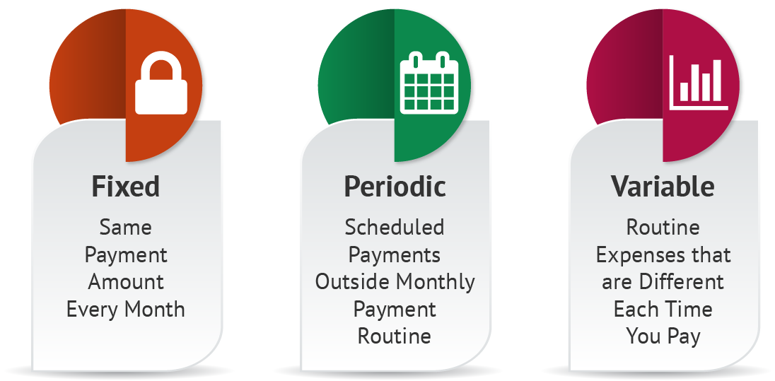
Expense Types
Identifying & Reducing Your Expenses
Budgeting

Slide 13
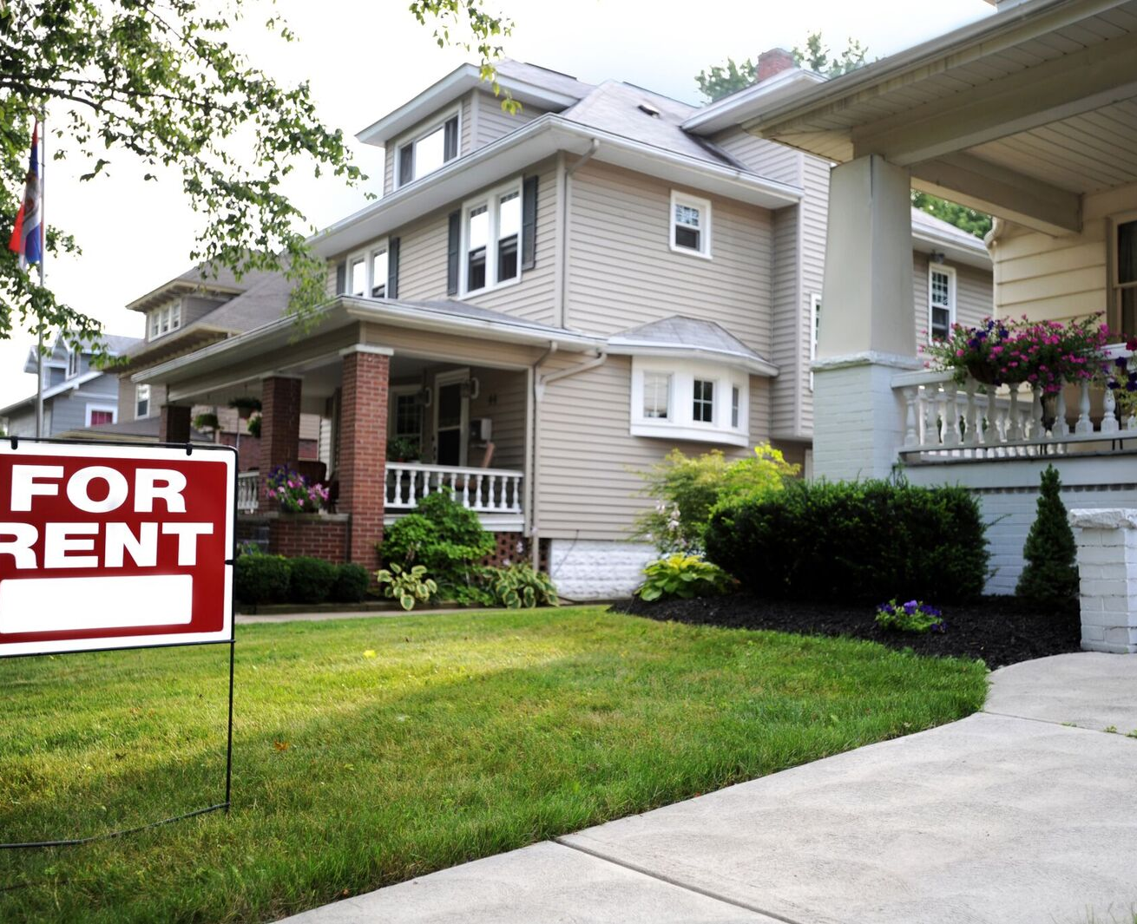
Fixed Expenses
Payment remains the same month-to-month
  Examples:
  Rent/mortgage
  Car payment
  Insurance premiums
Monthly gym memberships
Fixed expenses are easy to track and include in your budget
Identifying & Reducing Your Expenses
Budgeting

Slide 14

Periodic Expenses
Payable at intervals other than monthly
Examples:
  Car registration
  Quarterly subscriptions
Plan for periodic expenses by budgeting toward the expense
Calculate how much to save monthly for each periodic expense
Identifying & Reducing Your Expenses
Budgeting

Slide 15

Variable Expenses
Routine expenses that vary in amount each month
Examples:
  Groceries
  Eating out
  Entertainment
  Personal care
Tips to keep variable expenses under control:
  Open a separate checking account with a set amount to spend on variable expenses
  Track spending using a spreadsheet or mobile app
Identifying & Reducing Your Expenses
Budgeting

Slide 16

Consider Carefully: Do I Really Need This Expense?
If NO:
  Stop
  Sell
  Cancel
If YES:
  Reduce
  Negotiate
  Transfer
  Manage
Notes:
https://www.dropbox.com/sh/qludafbi6vrosk2/AADsXbUTWsZ-RX0MBSF5GhGHa/iStock-992782254.jpg?dl=0

Slide 17

Evaluate Expenses and Assess Options
Reduce
How often do I incur this expense? Can I cut back?
Negotiate
Can I get a better deal?
Transfer
Can I lower expenses by switching service providers?
Manage
Can I manage this expense more effectively?
Identifying & Reducing Your Expenses
Budgeting

Slide 18



Rent Negotiation
Research rents in your area
Be a ‘no-hassle’ tenant
Offer multiple months’ rent up front in exchange for lower rate
Opt out of shared amenities
Be clear that you’re ready to move out
Offer your landlord something in exchange
Set appropriate expectations
Identifying & Reducing Your Expenses
Budgeting

Slide 19

Reducing Home Ownership Expenses
Mortgage: refinance your loan
Property taxes: consider an updated appraisal
Maintenance: preventive maintenance can save money long-term
Identifying & Reducing Your Expenses
Budgeting

Slide 20

Reducing Utility Expenses
Electric, Gas, Water: look for ways to reduce consumption; explore discount options
Cell Phone: buy less expensive phones; review your bill for unnecessary services; prepaid or no-contract plans
Landline Phone: negotiate for bundle packages
Internet & Cable: negotiate rates; bundle services; switch providers
Identifying & Reducing Your Expenses
Budgeting

Slide 21
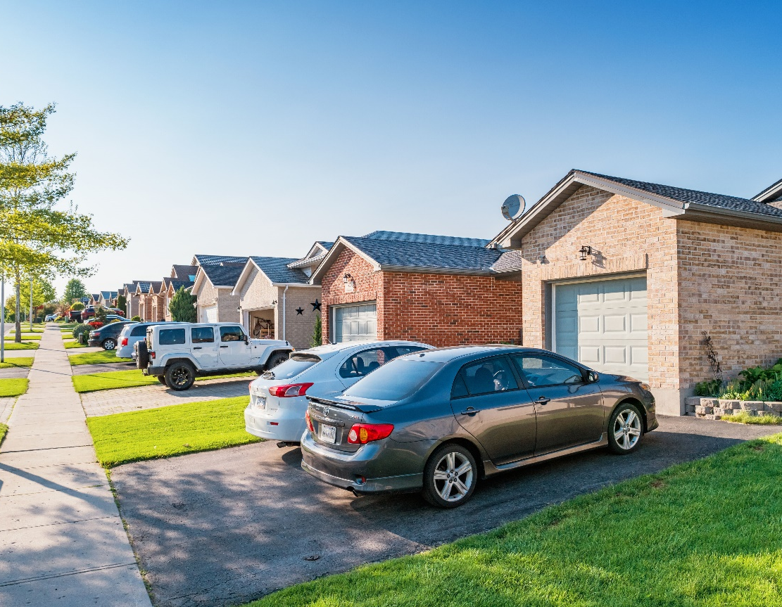
Reducing Transportation Expenses
Vehicle Loans: refinance; buy a used car; pay down high-interest loans
Vehicle Leases: good for small business owners
Fuel: shop for low prices; keep tires inflated; practice defensive driving.
Car Maintenance: stick to the regular service schedule.
Public Transport: check out available options; buy monthly or quarterly passes.
Insurance: go online to compare value and prices.
Identifying & Reducing Your Expenses
Budgeting

Slide 22

Reducing Loan & Debt Expenses
Don’t have debt in the first place!
Consolidation loans
Never go into debt to pay for living expenses
Avoid opening and canceling credit cards frequently
Schedule regular calls with creditors to inquire about interest rate reductions
Identifying & Reducing Your Expenses
Budgeting

Slide 23

Reducing Fees & Charges
Account Fees: ask the bank to waive them.
Credit Card Fees & Interest: negotiate; pay on time; never exceed credit limit.
Late Fees: set up autopay to avoid any late fees.
Overdraft Fees: explore overdraft protection; monitor your account and budget.
Identifying & Reducing Your Expenses
Budgeting

Slide 24

Reducing Variable Personal Expenses
Groceries: coupons; buy in bulk.
Vitamins/Supplements: look for generics; compare labels.
Subscriptions: multi-year plans often discounted.
Personal Care: shop sales; use beauty school apprentices.
Education: scholarships; employer subsidies; reduced membership prices; used books.
Identifying & Reducing Your Expenses
Budgeting

Slide 25

Reducing Variable Personal Expenses
Health & Fitness: gym specials; generic prescriptions; wait for frame and lens sales.
Kids & Caregiving: coupons and memberships for activities; coordinate care with family, friends, neighbors.
Pets: buy food in bulk; free or discount vaccination clinics.

Slide 26

Create Your Budget & Automate
Create Your Budget & Automate
Budgeting

Slide 27
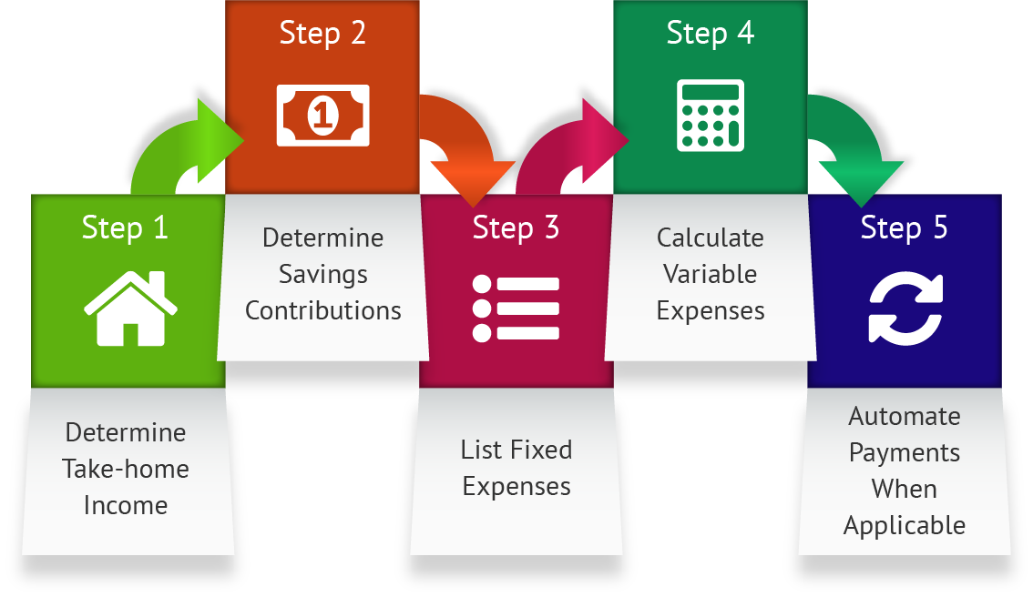
Steps in Creating a Budget
Create Your Budget & Automate
Budgeting

Slide 28

Budget Components
Income
  Take-home pay from work; tips; any other compensation.
Savings
  Set aside at least 10% of your total income.
Fixed expenses
  Bills you pay the same amount each month (rent, car payment, insurance); for bills you pay annually, divide by 12 to enter monthly amount.
Variable expenses
  Bills where the amount varies each month (e.g. utilities based on usage), including incidental expenses (coffee, movies, events).
Bottom line
  Anything left over can be used to purchase “wants.”
Create Your Budget & Automate
Budgeting
Notes:
https://www.dropbox.com/sh/qludafbi6vrosk2/AAD015KNizS9oihpihIUpBtUa/iStock-137925642.jpg?dl=0

Slide 29



Budget Step 1
  Enter your income – Total net (take-home) pay, tips, and any other compensation.
Budget Step 2
  Plan your savings – Set aside at least 10% of your income before you purchase any “wants.”
Budget Step 3
  List fixed expenses – Rent, car payment, insurance. Account for annual fixed expenses (gym memberships, auto registration, etc.) by dividing the annual payment by 12.
Budget Step 4
  Calculate variable expenses – Coffee, movies, special events. Track variable expenses for a month and adjust accordingly.
Budget Step 5
  Set up your budget to automate and organize your finances online. This step will ensure that you can accurately monitor your budget and make adjustments.
Create Your Budget & Automate
Budgeting

Slide 30
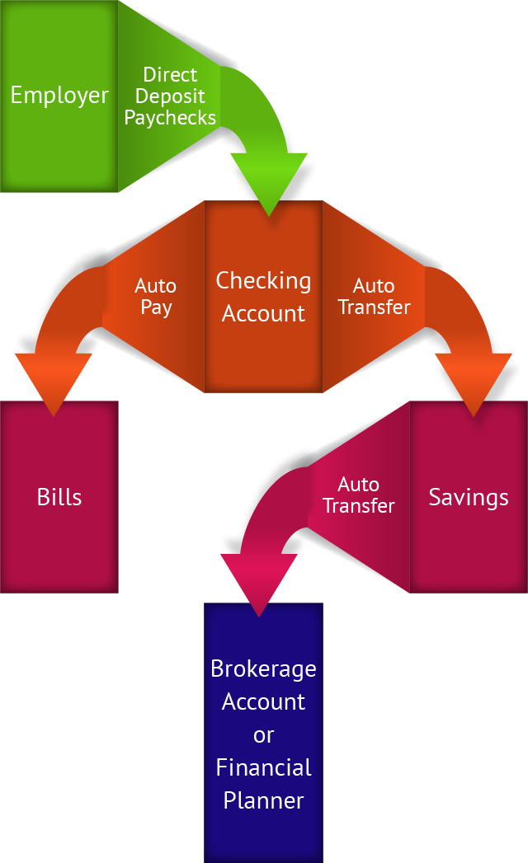
Set up Automated Accounts
Choose a financial institution
Set up checking and savings accounts
Set up direct deposit for your paychecks
Automate your bill payments
“Pay yourself” first by contributing to savings via automatic transfer
What’s left over?
Create Your Budget & Automate
Budgeting

Slide 31

Third-party Financial Tracking Systems
Allow you to connect all accounts on a single dashboard.
Pose two types of risk:
  Advertising exposure
  Account compromise
Carefully review advertising before buying to ensure that products are right for you.
Vary your user names and passwords between accounts to protect yourself from attackers.
Create Your Budget & Automate
Budgeting

